Slide 1
University of Diponegoro October 14th 2022
Applications of Geospatial and Remote Sensing
Technology in Environmental Studies
Magaly Koch, PhD
Center for Remote Sensing
Boston University
mkoch@bu.edu

Slide 2
Outline
Earth Observation Satellites (EO)
EO Data for Ecosystem Applications
EO Sensors for Ecosystem Services
Fundamentals of Remote Sensing
Case Study
  Irrigated Agriculture in Egypt

Slide 3
From Earth Observations to Applications

Slide 4
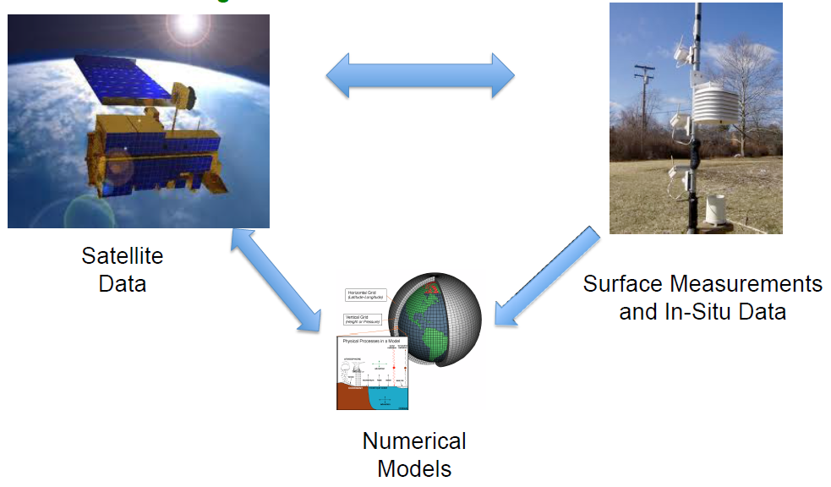
Models: Value Added Information
Remote Sensing + Ground Observations + Numerical Models

Slide 5
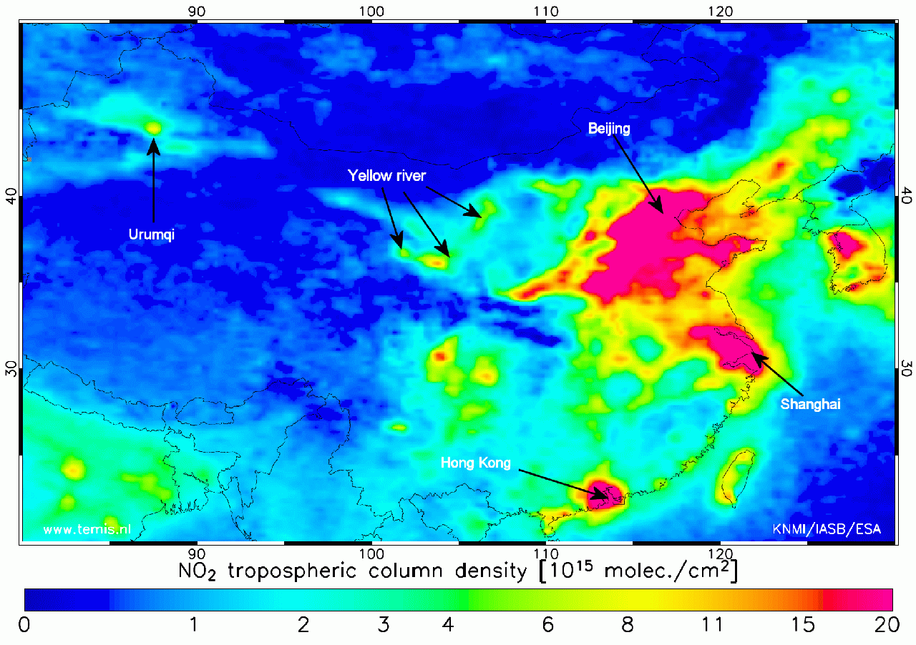
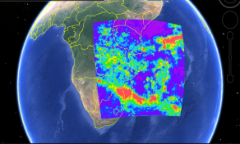
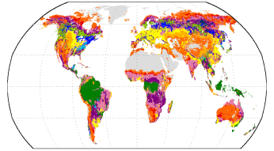

Remote Sensing Applications
Health (Air Quality)
Analysis of dust, fires,
& urban air pollution
Satellite and regional
air quality model comparisons
Support for air quality forecasting and exceptional event analysis
Water Resources & Flood
Flood/drought monitoring
Severe weather and precipitation
Watershed mgmt
Snow/ice monitoring
Evapotranspiration,
ground water, soil moisture, runoff
Nitrogen Dioxide over China
Satellite derived precipitation
Land Use/Change and Ecology
Land cover and change
Vegetation amount and health
Fire products
Land Cover
LAND COVER

Slide 6
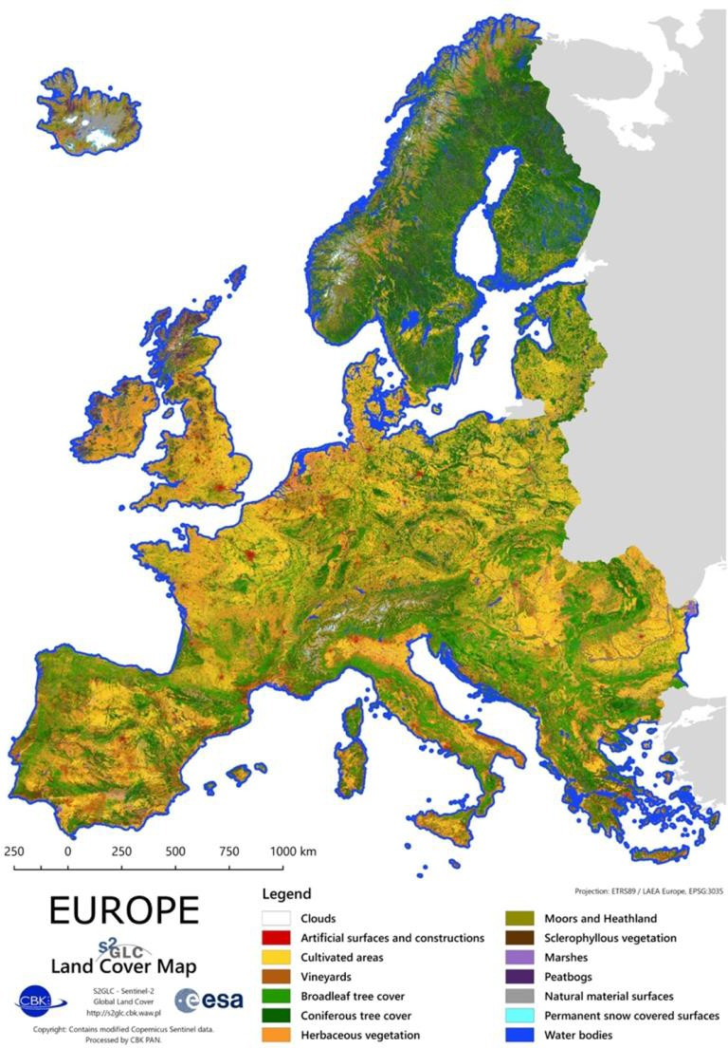
Remotely-Sensed Data for Ecosystem Services
Spatial Data used in 80% of assessments
Earth Observations (EO) are an important tool
Benefits to use of EO:
  Spatially Explicit
  Rapid Assessment: Becoming more easily available over multiple platforms
  Cost Effective
  Regular, Repeatable Observations
  Access to Remote Locations
  Global (mostly)

Slide 7
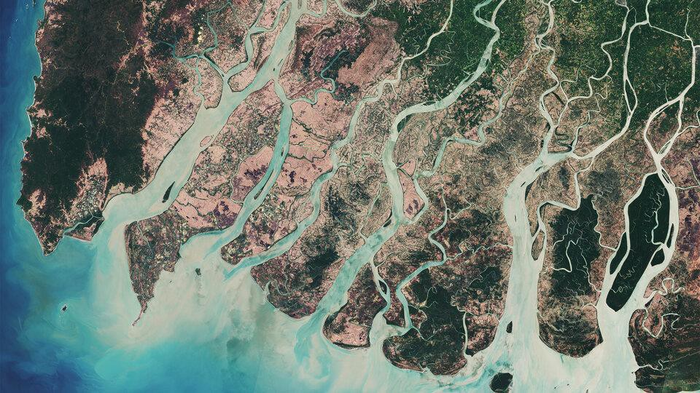
Remotely-Sensed Data for Ecosystem Services
Land Cover Mapping: Proxy assessment of ecosystem characteristics
Change Monitoring
Additional Biophysical Information:
  Elevation
  Climate Variables
    Precipitation
    Temperature
  Hydrology/Water Cycle
  Primary Productivity
  Carbon Storage
  Canopy Structure
  Woody Biomass
Mangroves, Image Credit: ESA

Slide 8
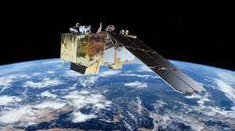
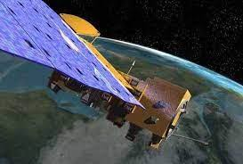
Satellites and Sensors for Ecosystem Services
Landsat
Sentinel-2
MODIS
VIIRS
AVHRR
Hyperion
Sentinel-1
ALOS/PALSAR
Sentinel-2 (top), Terra MODIS
(right)

Slide 9

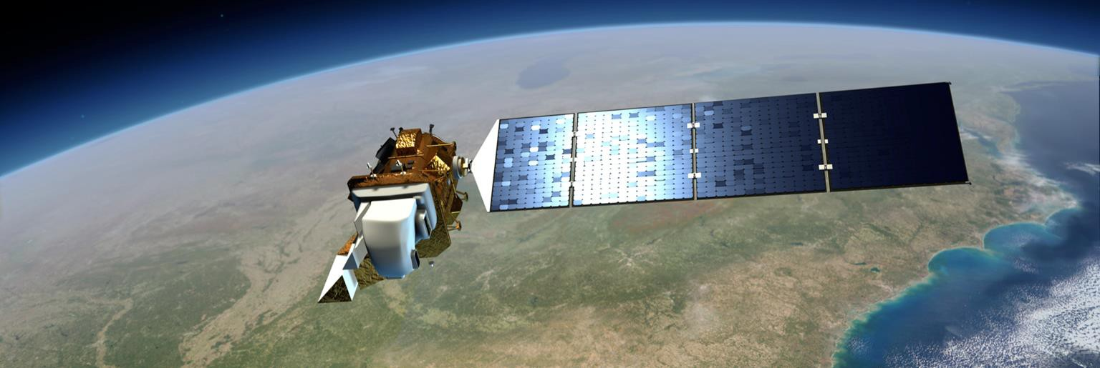

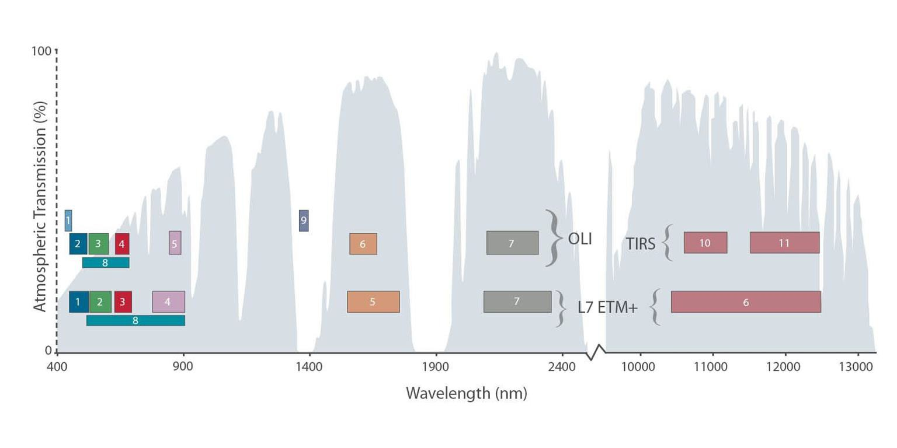
Landsat
First Landsat launched in 1972
Landsat 8 launched in 2013
NASA created and launched
– USGS maintains data
Passive Sensor – Obtains values of reflectance from Earth’s surface
30-meter pixels, 15-meter panchromatic band
Landsat 8
Landsat 4,5,7

Slide 10
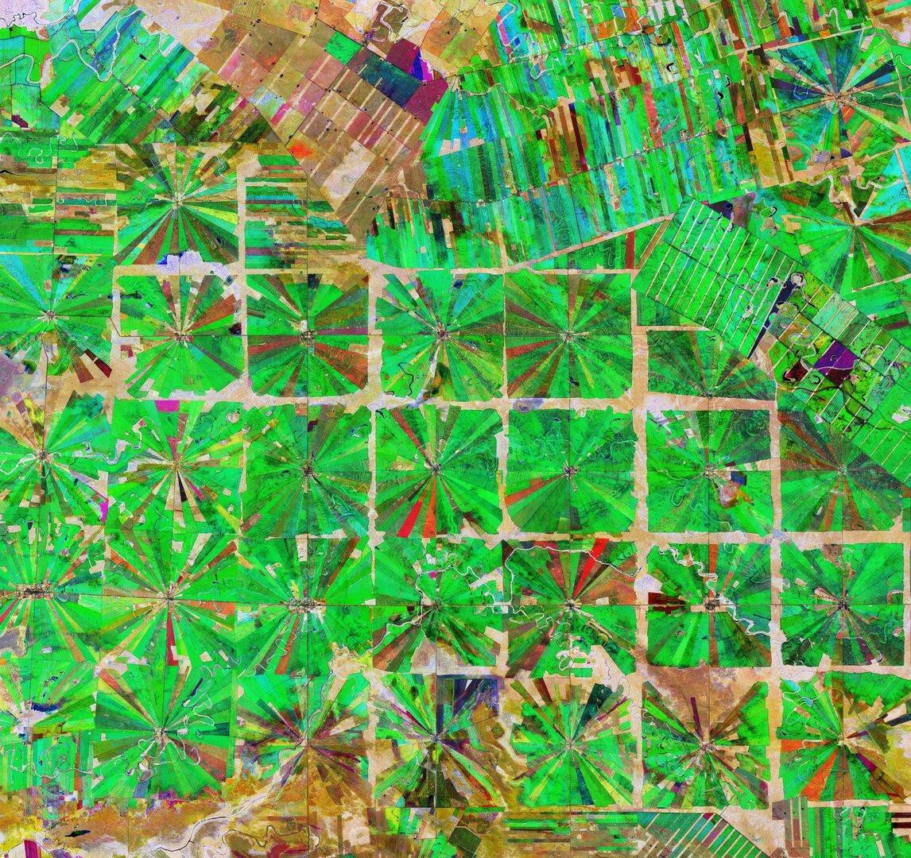
Sentinel-2
Launched in 2015
13 spectral bands
Spatial Resolution:
  Red, Green, Blue (RGB) at 10 meters
  Near-Infrared and Shortwave Infrared at 20 and 60 meters
Revisit Time: ~5 days
Often combined with Landsat for continuity
  Harmonized Sentinel-2 and Landsat surface reflectance products available
Composite Sentinel-2 image of forests converted to farmland in Brazil, 2019. Image Credit: ESA

Slide 11
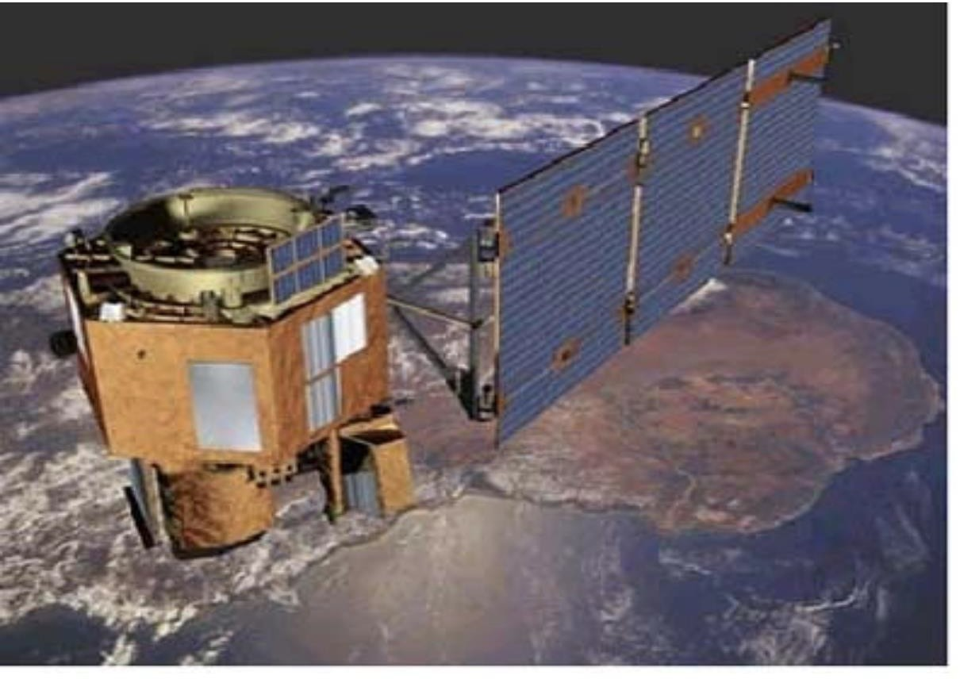
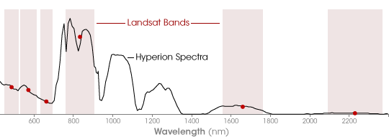
EO-1 Hyperion
Date Range: 2000-2017
220 spectral bands
357 to 2567 nm
10 nm bandwidth
30 m spatial resolution
7.75 km swath
12-bit
Hyperion image of Mount. Fuji, 2000 (left), the Hyperion sensor (top), and a comparison of the Landsat bands and a spectra from Hyperion.
Image Credit: USGS

Slide 12
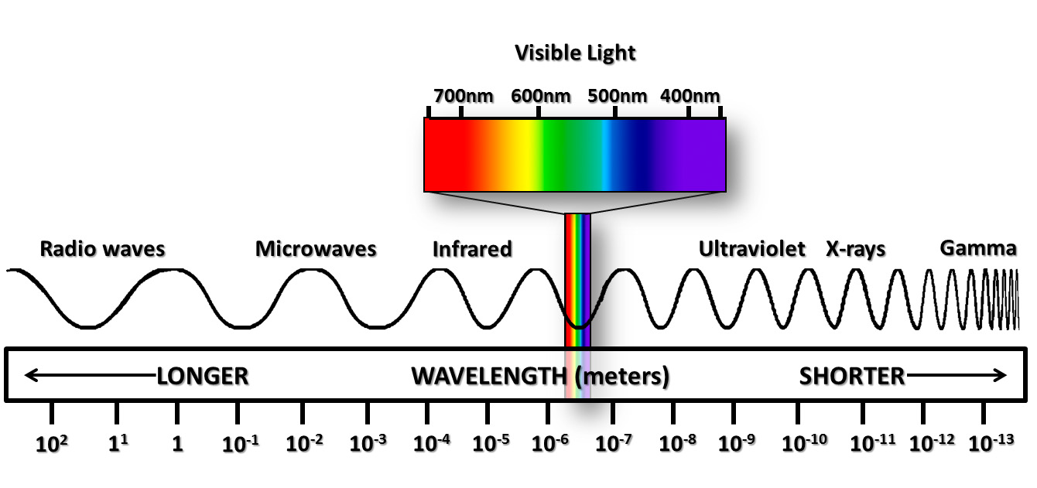
Basic Understanding of Remote Sensing
Electromagnetic Spectrum

Slide 13
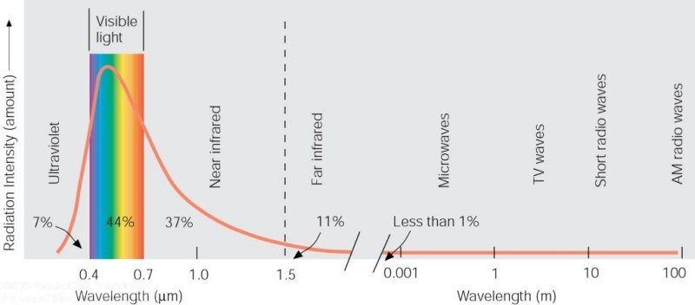
Electromagnetic Spectrum
Shortwave or Solar Radiation
Longwave or Terrestrial Radiation

Slide 14
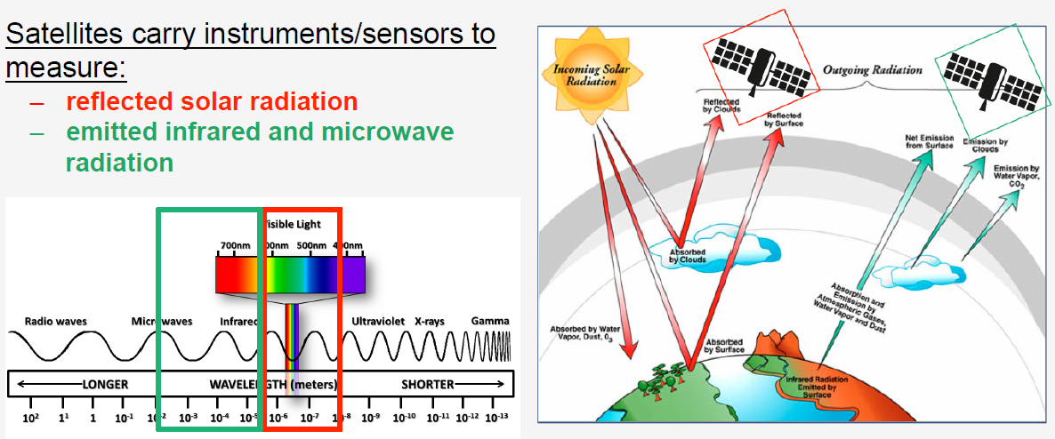
Overview of Remote Sensing
Notes:
The overall imaging system is a complex one involving the scattering or emission of energy from the surface, followed by transmission through the atmosphere to instruments mounted on the remote sensing platform. The data is then transmitted to the earth’s surface, after which it is processed into image products ready for application by the user. The most significant characteristic of the image data provided by a remote sensing system is the wavelength, or range of wavelengths, used in the image acquisition process.

Slide 15
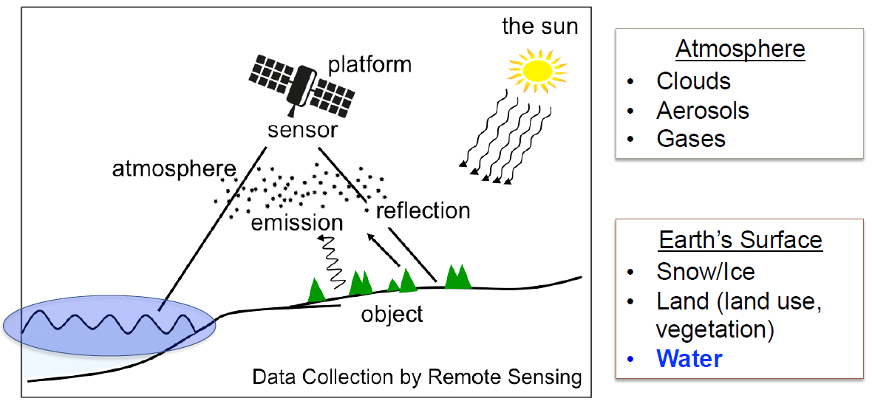
What Do Satellites Measure?

Slide 16
Products for Land Resources Management
Land cover maps
  Many different sources: regional, national and global
  Single snapshot in time
  Land cover classification varies
Vegetation Indices (NDVI, EVI, SAVI, etc.)
  Many different sources at different spatial resolutions
  Can get time series
Other (Fire perimeters, burn severity)
  A few sources at different spatial resolutions
Change Detection
  New methods are using the freely available Landsat time series to get annual (or monthly) change

Slide 17
Satellite Data Processing Levels
Level 1 and Level 2 data products have the highest spatial and temporal resolution
Level 3 and 4 products are derived products with equal or lower spatial and temporal resolution than Level 2 products.
L0: Raw instrument data
Harder to Use
L1: Geolocated and calibrated
L2: Products derived from L1B
L3: Gridded and quality controlled
L4: Model output: derived variables
Easier to Use

Slide 18
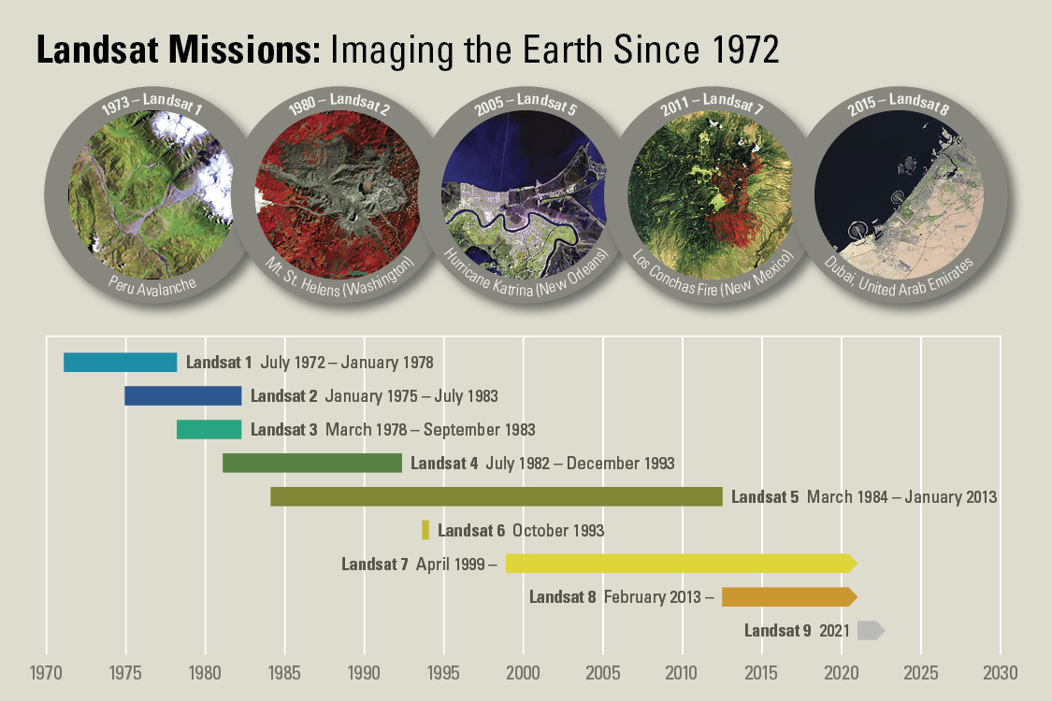
Landsat Mission

Slide 19
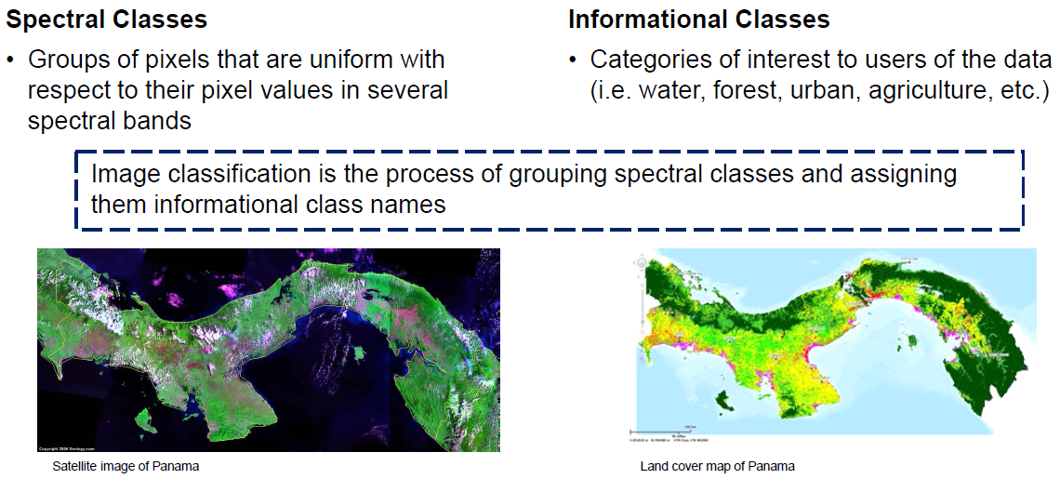
Turning Data into Information
Spectral versus Informational Classes

Slide 20
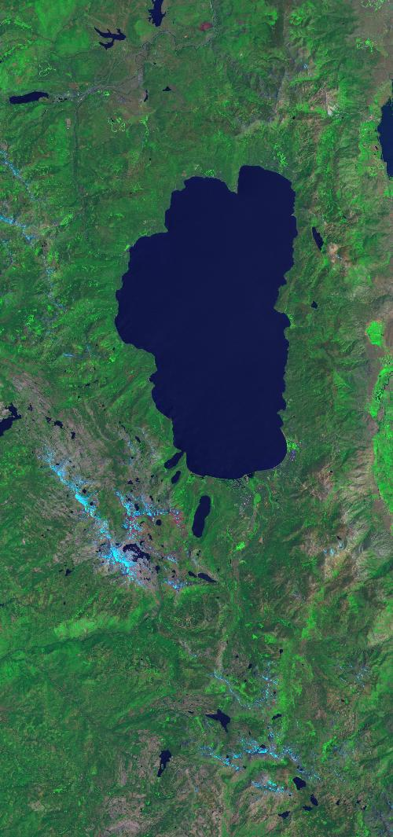
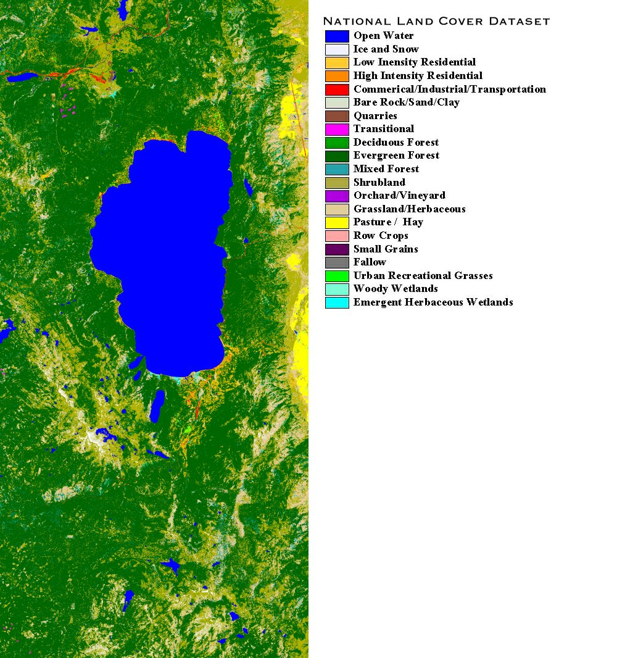
Turning Landsat Data into Land Cover Types
Landsat image of Lake Tahoe
Land cover map of Lake Tahoe

Slide 21
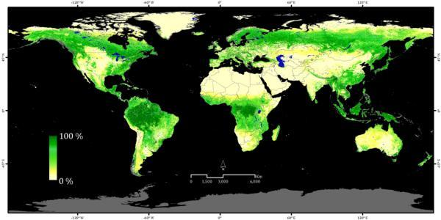
Global 30m Landsat Tree Canopy
https://lcluc.umd.edu/metadata/global-30m-landsat-tree-canopy-version-4
source: glcf.umd.edu
Landsat Tree Cover layers estimate the percent of tree cover per 30m pixel area (includes stems, branches, leaves of woody vegetation greater than 5 meters in height)
Derived from all seven bands of Landsat 5-TM and Landsat 7- ETM
Landsat Tree Cover product represents 2000, 2005, 2010, 2015
Notes:
The release of version 4 Tree Canopy Cover (TCC) product, replaces the previous version of global tree canopy cover estimates for 2000, 2005, 2010, and 2015. It also includes annual tree cover estimates from 2010 to 2015 for North and South America. More information about this dataset can be found here: https://lpdaac.usgs.gov/products/gfcc30tcv003/

Slide 22
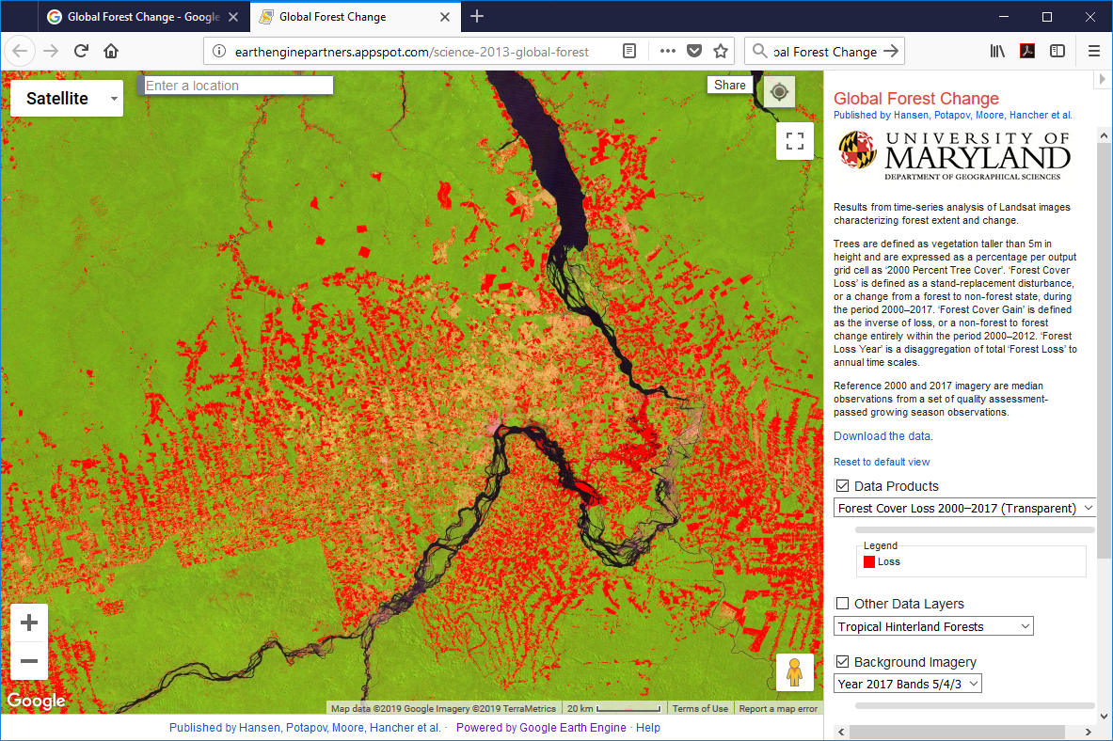
Global Forest Change
Time-series analysis of Landsat images characterizing forest extent and change.
https://glad.earthengine.app/view/global-forest-change

Slide 23
Remote Sensing Case Study
Agricultural Activity and Crop Water Use
In the Upper Nile Region of Egypt

Slide 24
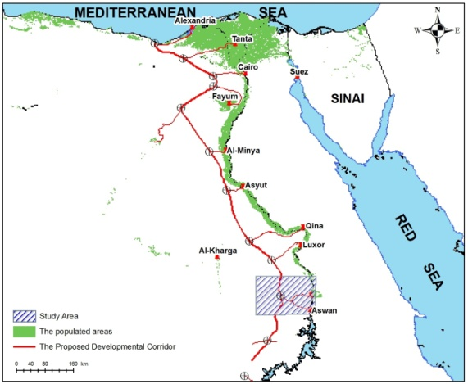
Proposed Development Corridor in Egypt
Aswan Sector
Evaluate the combined use of satellite and ground penetrating radar data to delineate the potential areas for groundwater accumulation in a desert area west of Aswan, Egypt
CIEMAT, Madrid, Spain – 27 June 2011
Notes:
Agriculture is the most important consumer of fresh water in Egypt. It consumes about 95% of its natural water resources. With the increase of Egypt’s population from 66.1 million in 2000 to 83.4 million in 2014 (FAO, 2015), sustainable development of agricultural areas has become a strategic priority to satisfy growing food demands. Traditionally Egypt has relied on water from the River Nile as the main source for irrigated agriculture. However, Egypt’s allocated Nile water share is fixed at 55.5 billion cubic meters per year. Furthermore, natural fertile land encompasses only 5% of the country and is increasingly being subjected to soil degradation (soil pollution) and urban encroachment due to population pressure.

Slide 25
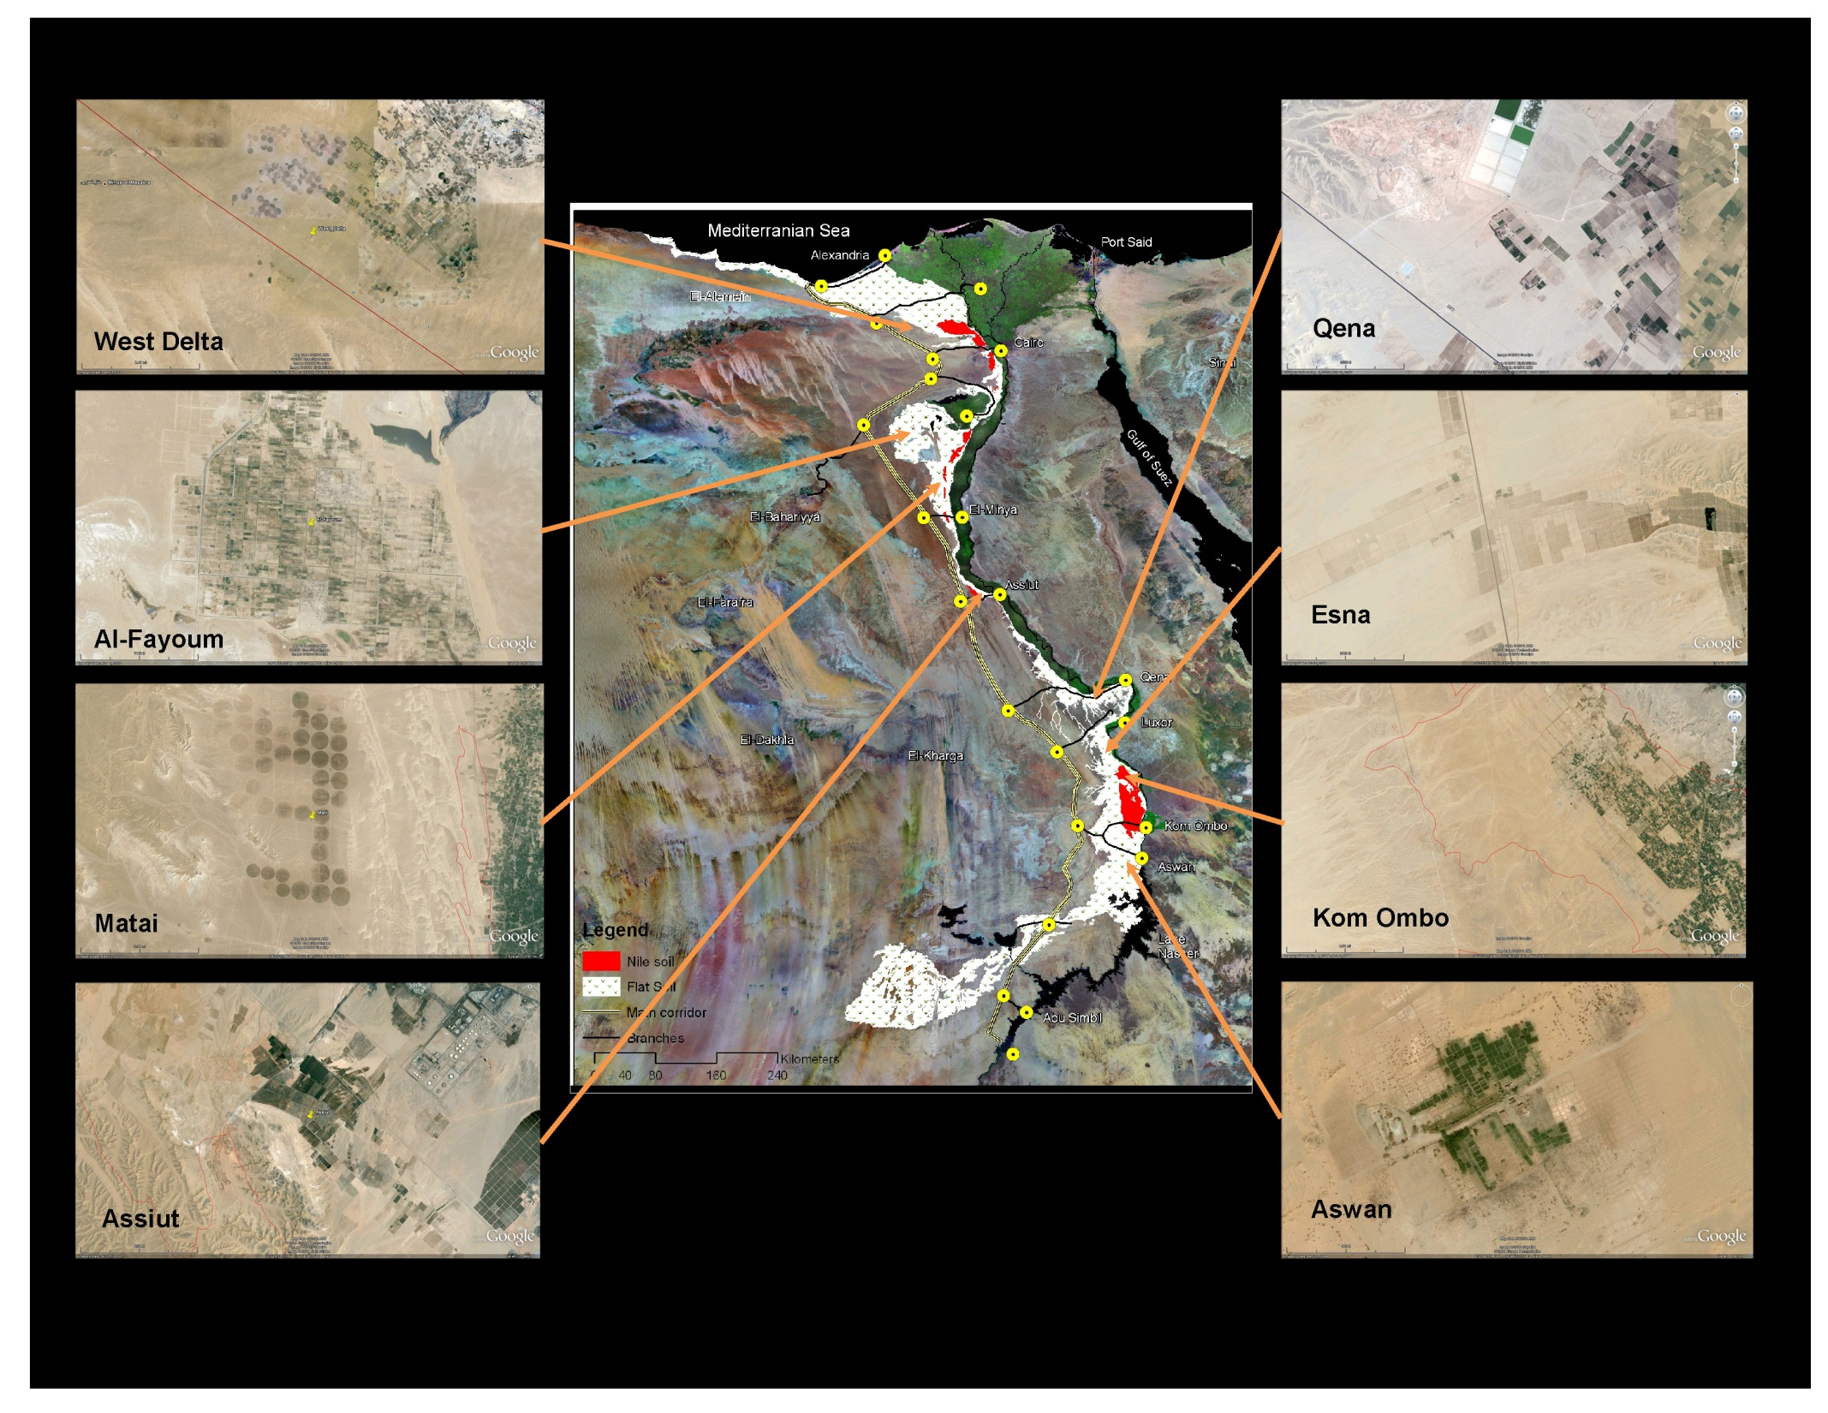

Slide 26
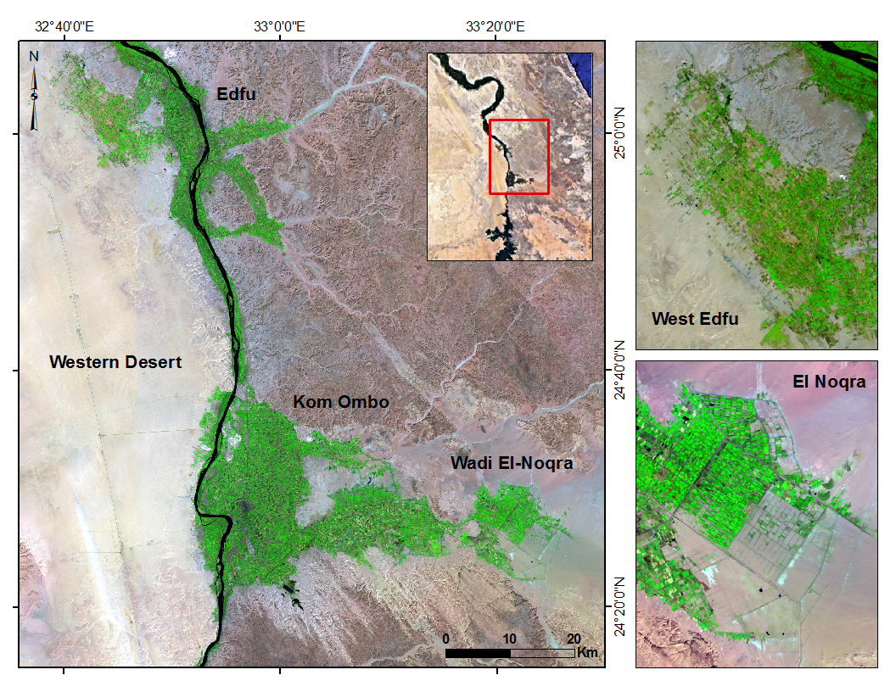
Cropland Expansion in Upper Egypt

Slide 27
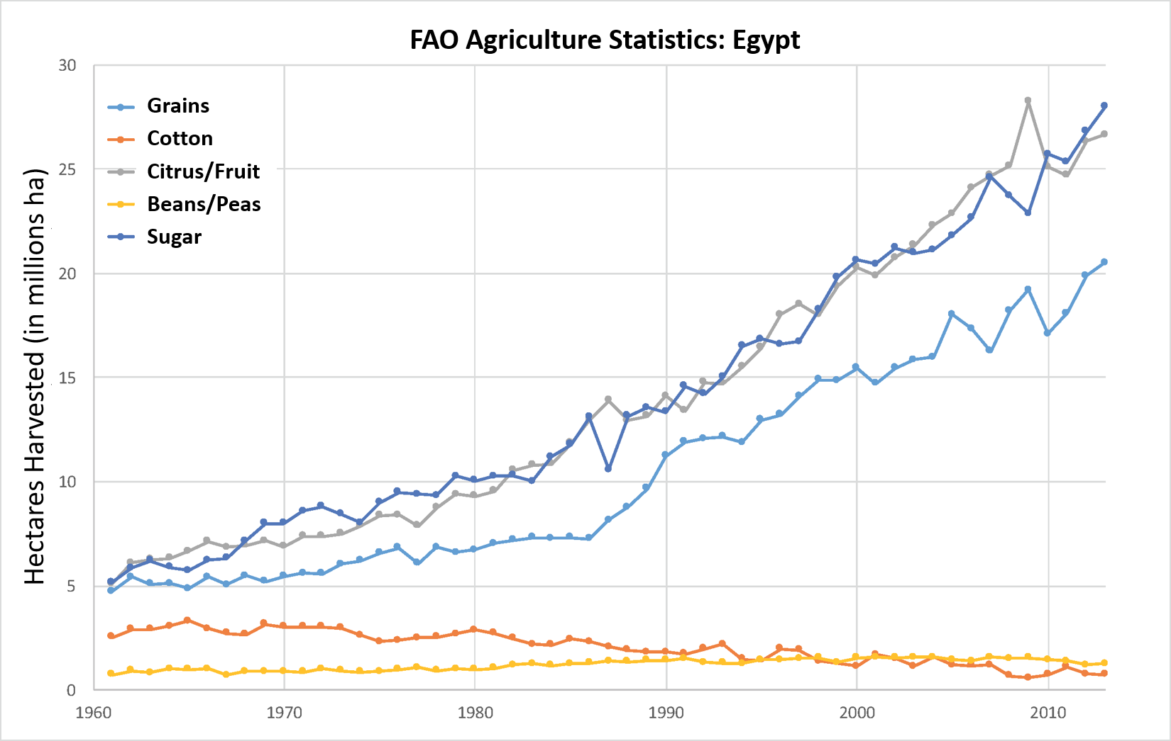
Changes in Crop Cultivation in Egypt
FAO Agricultural Statistics (FAOSTAT, 2015)
Notes:
Cultivation trends in Egypt have changed dramatically in recent decades. The FAO agricultural statistics (2015) report that Egypt experienced a significant increase in grains, citrus/fruits and sugarcane starting in the 1980’s and a gradual decrease in cotton plantations around the same period.

Slide 28
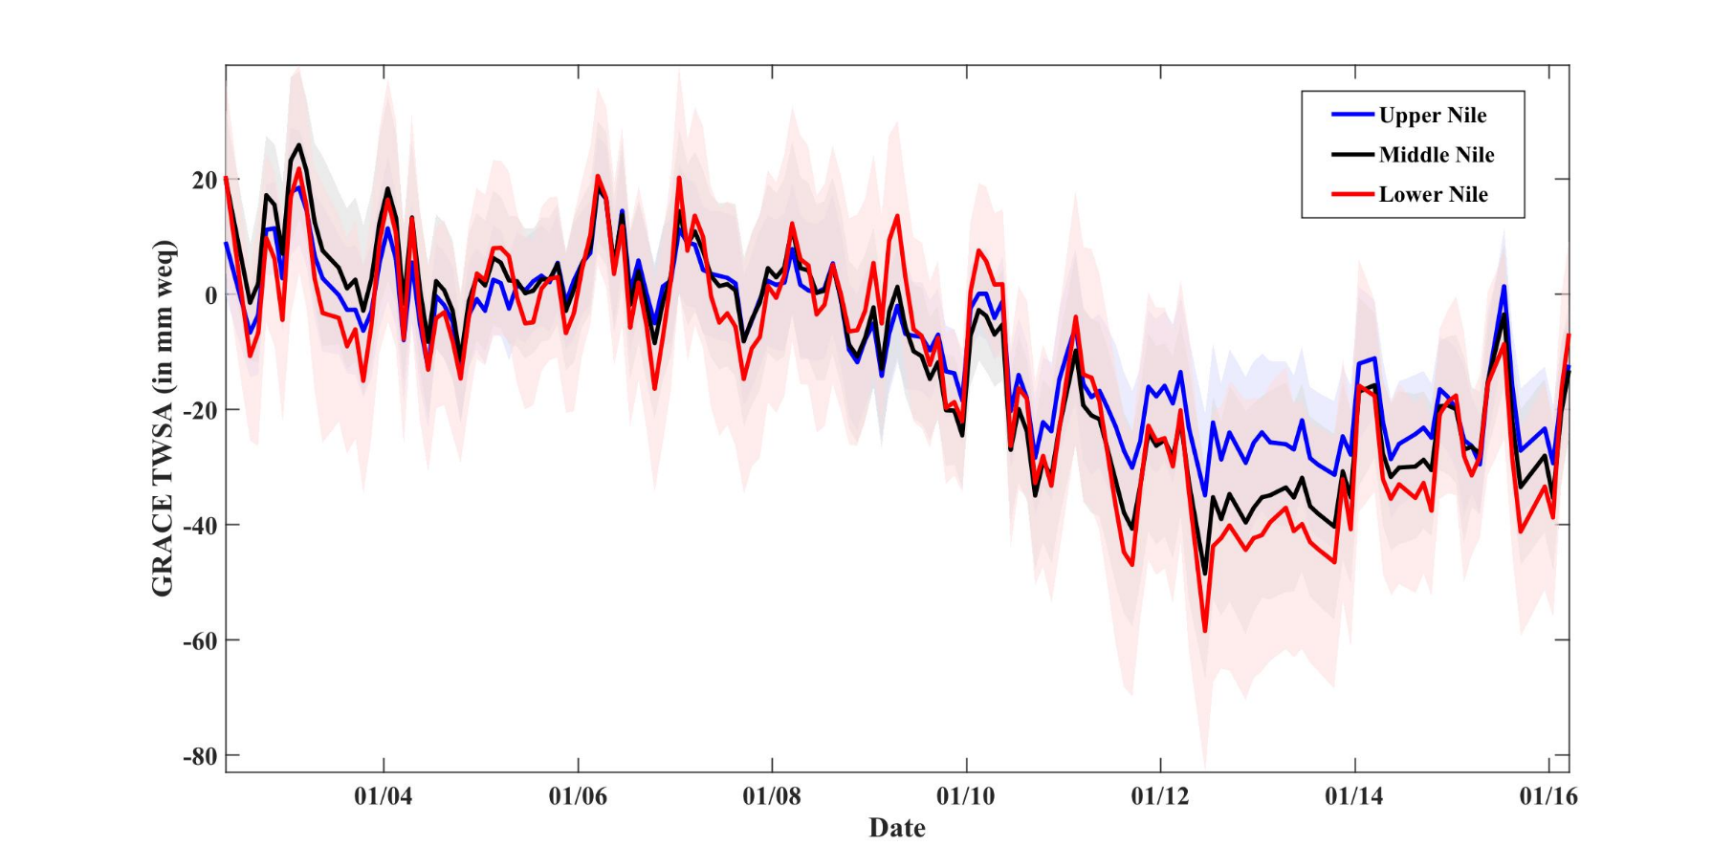
Changes in Water Volume in Egypt
GRACE Terrestrial Water Storage Anomalies (TWSA) between 2002-16:
A dry period in mid-2012 more negatively impacted TWSA in the lower Nile as compared to the Upper Nile.
Notes:
Changes in terrestrial water storages, termed anomalies, as observed from the GRACE satellites provide observations in storage changes related to the sum of changes in soil moisture, groundwater, surface water (rivers and reservoirs) and snowpack. Changes are measured in mm of water equivalent height (weq). This figure shows coherent TWSA dynamics, with a clear deviation in regional TWSA behaviors apparent starting in 2010; for example, a dry period in mid-2012 more negatively impacted TWSA in the Lower Nile as compared to the Upper Nile. An unknown influence in this behavior is the relationship between Lake Nasser storage and changes in agricultural water use.

Slide 29
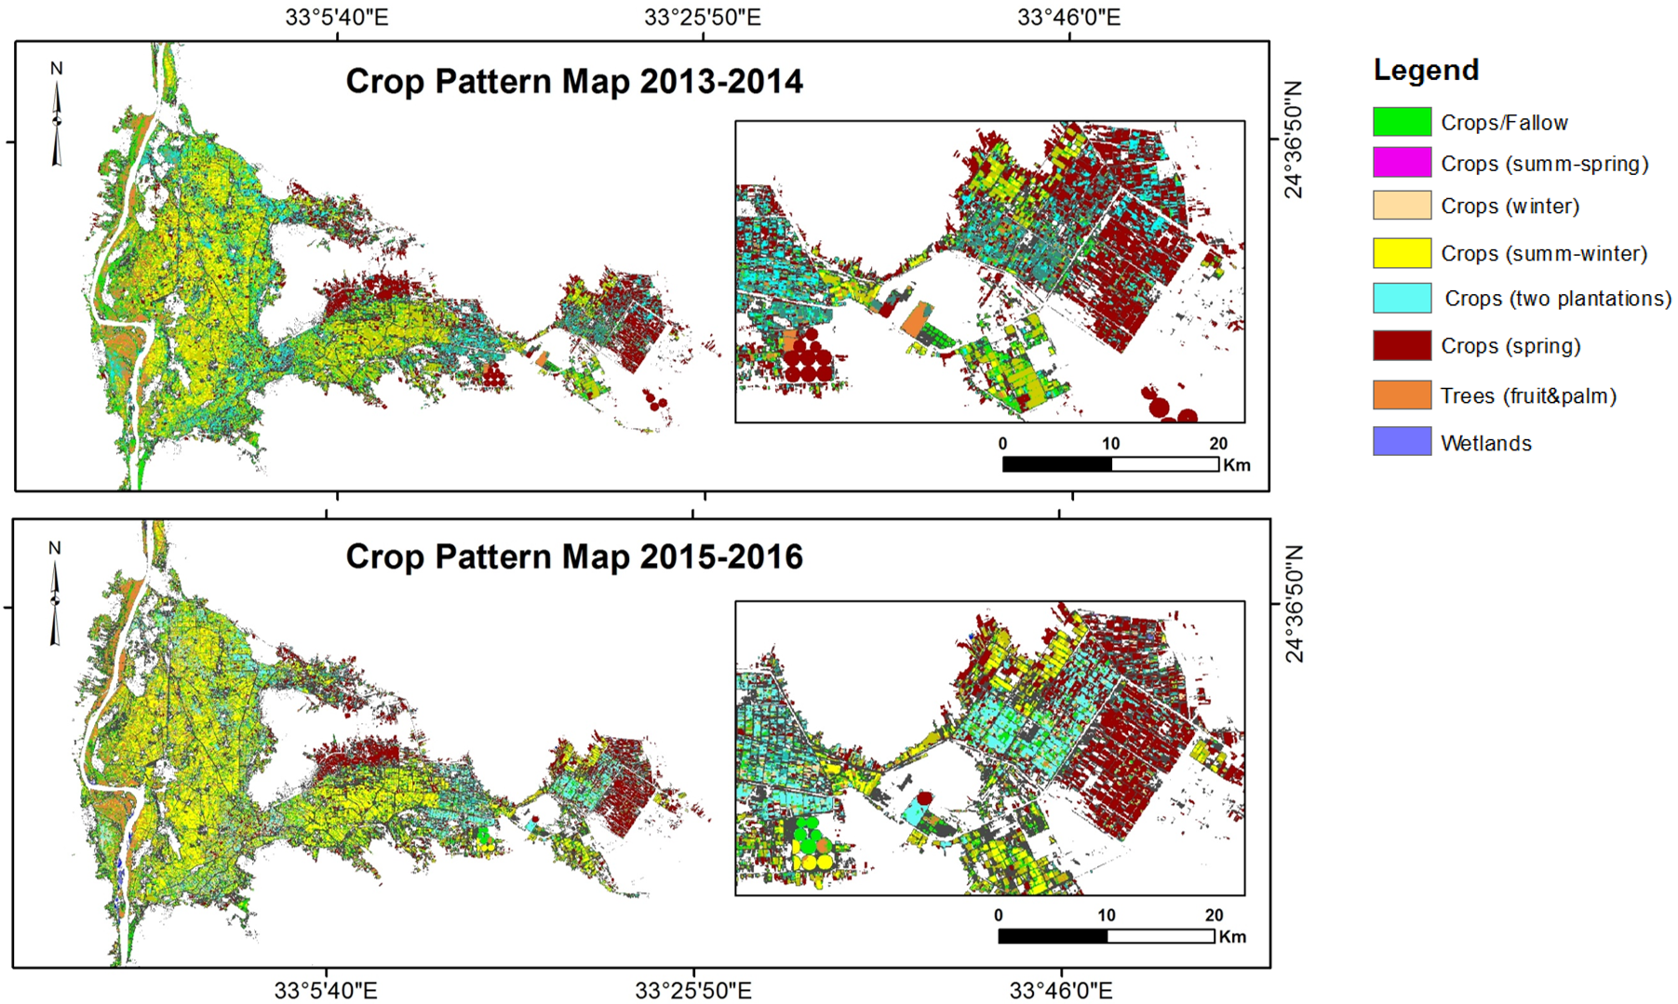
Cropping Pattern in Kom Ombo Agricultural Region
Landsat time series classification of cropping patterns
Notes:
Landsat time series of cropping patterns for assessing agricultural activities in Kom Ombo region. A set of Landsat 8 images (at least one Landsat image per month) was used to extract NDVI time series, followed by a principal component analysis to increase inter-band variance before applying a clustering algorithm (unsupervised method) to obtain crop pattern classes. Classes were subsequently examined and labeled based on their corresponding NDVI time series profiles and spectral reflectance curves. Crop pattern clusters are not necessarily made up of the same type of crops but rather show crops with similar phenological behavior throughout an agricultural calendar year (starting in May and ending in April).

Slide 30
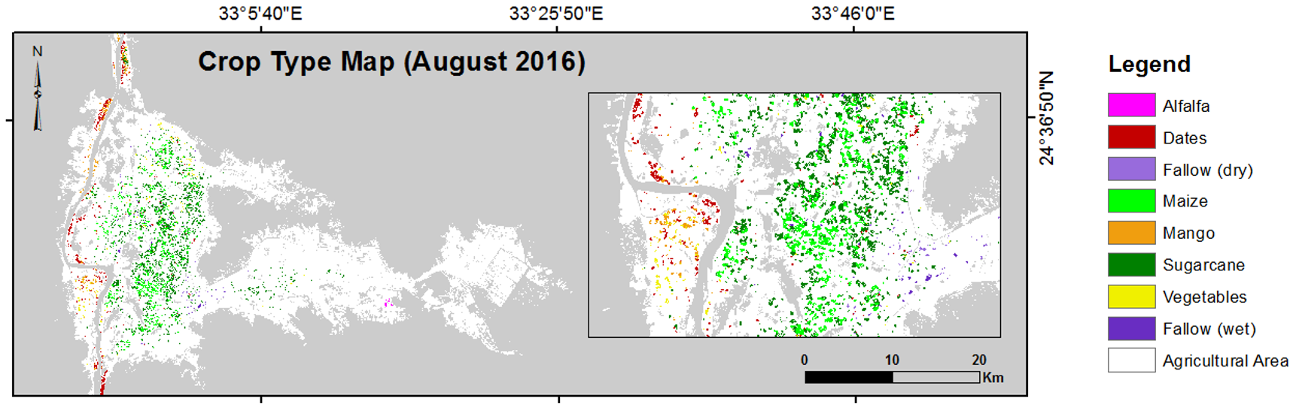
Selected Crop Types in Kom Ombo Region
Supervised classification of a Landsat scene (August 2016) shows the distribution of major crop classes as obtained after applying a MLC probability threshold of 50% or greater. Large areas remained unclassified due to small field sizes that cause mixed pixels.
Notes:
In other words, only relatively homogeneous and large crop fields are depicted in this figure. The class distribution confirms that (1) the summer-to-winter crop class of the time series cropping map (previous slide) spatially corresponds to sugarcane and maize fields in this figure and are largely confined to areas close to the Nile; (2) mixed crop fields (vegetables) are predominantly smaller in size and found along the Nile Valley as well as in new reclaimed areas.

Slide 31
Vegetation Indices
60
Healthy
Vegetation
Reflectivity (%)
40
Dry
Vegetation
20
Soil
0
0.4
0.5
0.6
0.7
0.8
0.9
1.0
1.1 µm
R
IR
Normalized Difference Vegetation Index
Notes:
Normalized difference vegetation index (NDVI) time series derived from satellite data is capable of discriminating phenological characteristics of crops and other vegetation types.

Slide 32
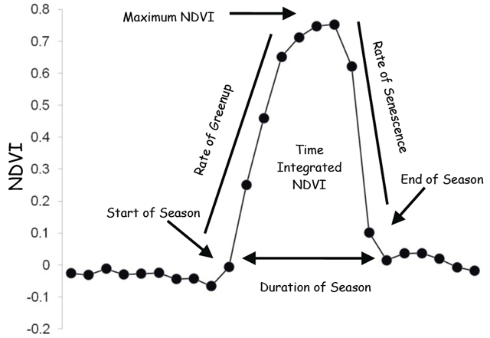
NDVI Phenology
NDVI Time Series
  Start of season time/NDVI
  End of season time/NDVI
  Time of Maximum NDVI
  Length of growing season
  Maximum increase in canopy
  Photosynthetic activity across entire growing season
http://phenology.cr.usgs.gov
Notes:
Remotely sensed phenological data are useful for assessing crop conditions, drought severity, and wildfire risk as well as tracking invasive species, infectious diseases, and insect pests. Ideally the NDVI temporal profile of a Landsat pixel is a smooth curve reflecting gradual transitions between growing stages. Due to error sources such as cloud cover, water, snow or shadow, noise with false low values are added to NDVI time series. Phenological metrics derived from remotely sensed data have great potential to characterize crop growth in a large area.

Slide 33
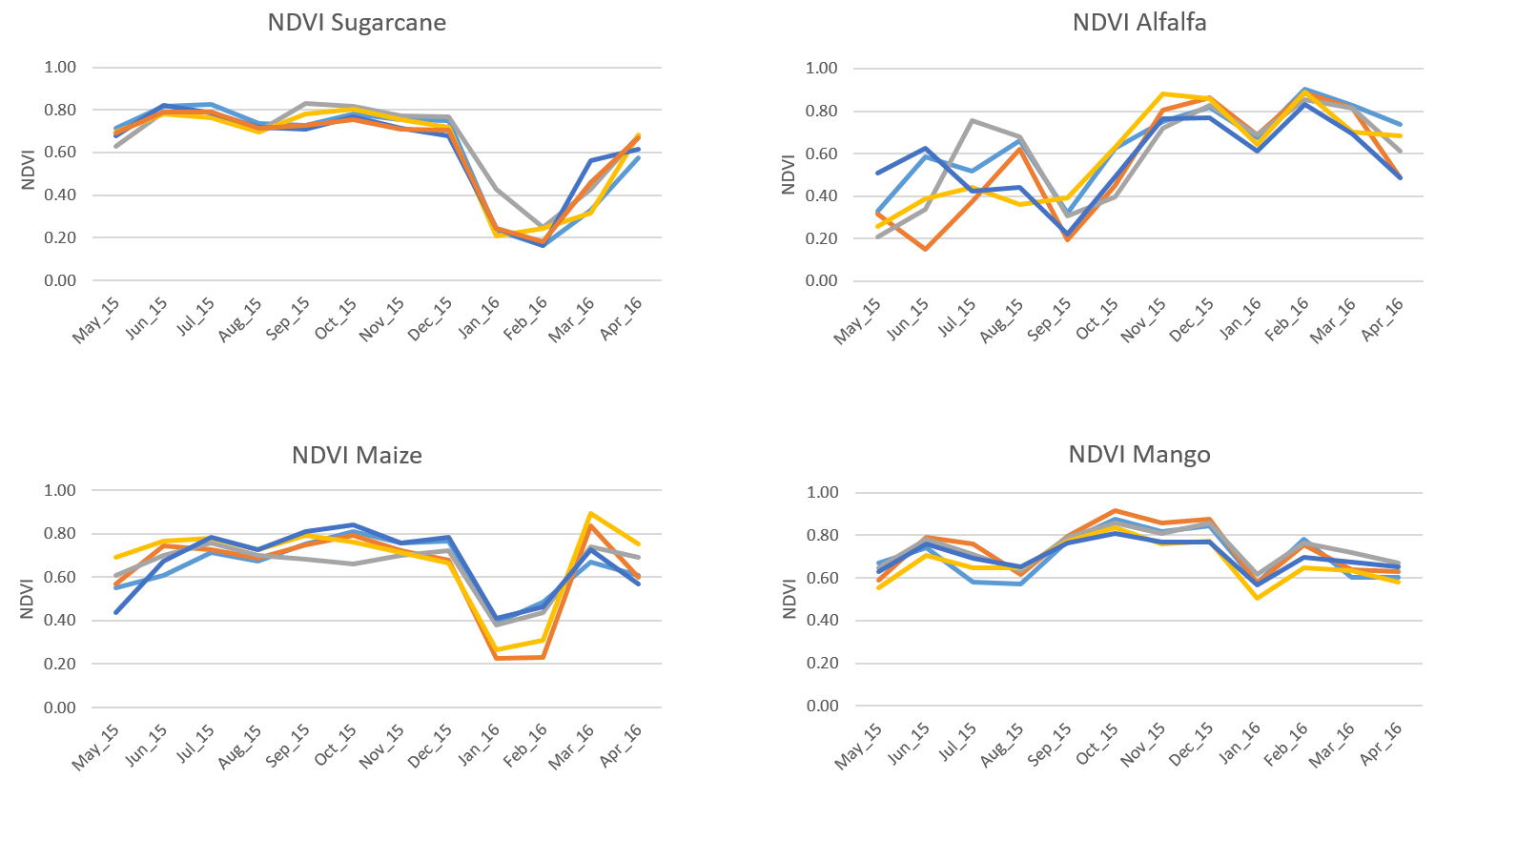
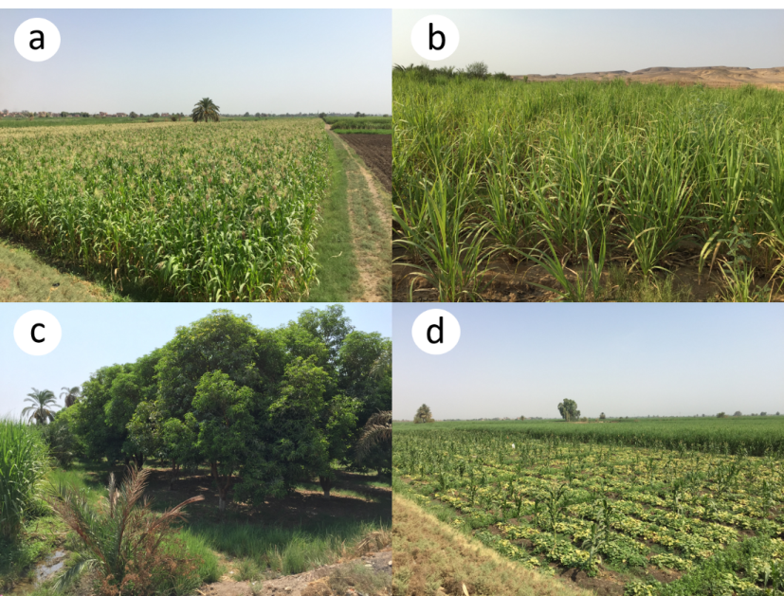
NDVI Time Series Profiles for Selected Crop Types
NDVI profiles extracted from Landsat time series covering 1 year period (2015 – 2016)
Photos of major crop types found in Kom Ombo agricultural region: a) maize, b) sugarcane, c) mango, and d) vegetables (zucchini) in the foreground and sorghum in the background.

Slide 34
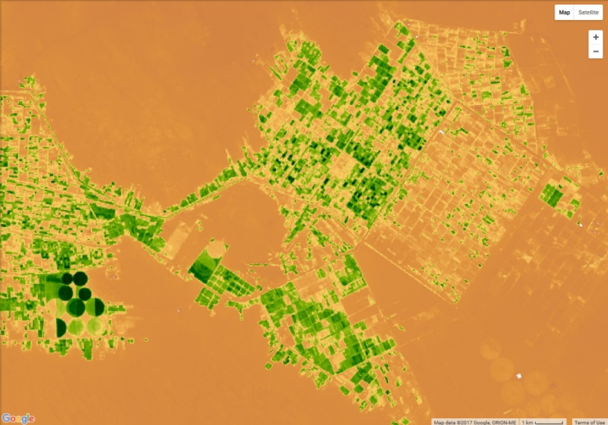
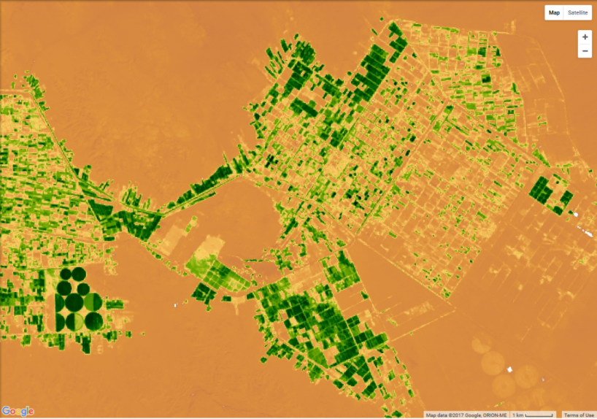
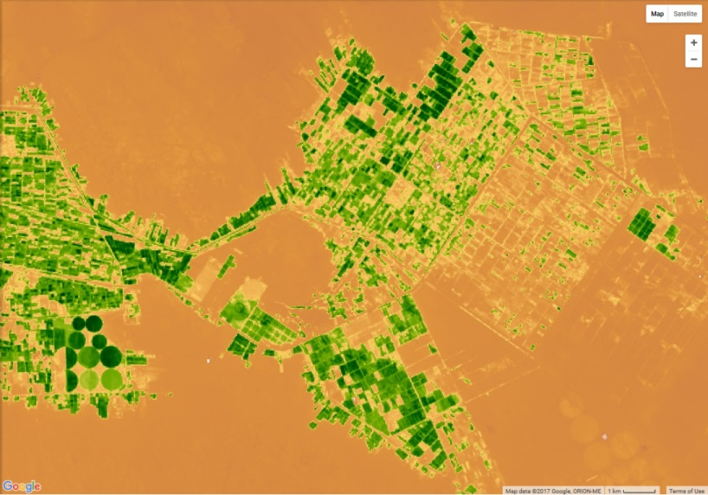
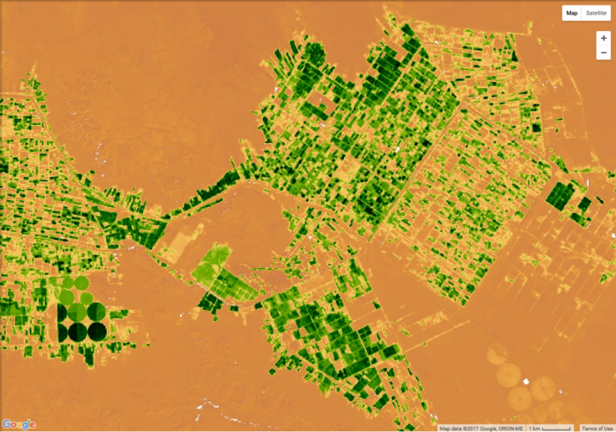
Vegetation Index Time Series – El Noqra Agricultural Expansion
May-June 2015
Sep-Oct 2015
Jul-Aug 2015
Nov-Dec 2015
EVI
High
Low

Slide 35
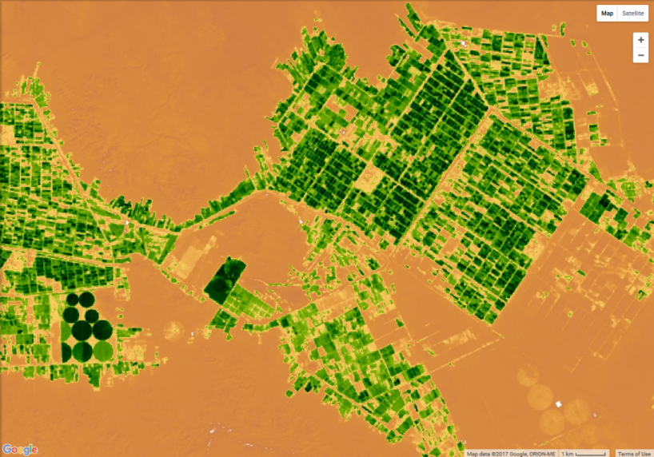
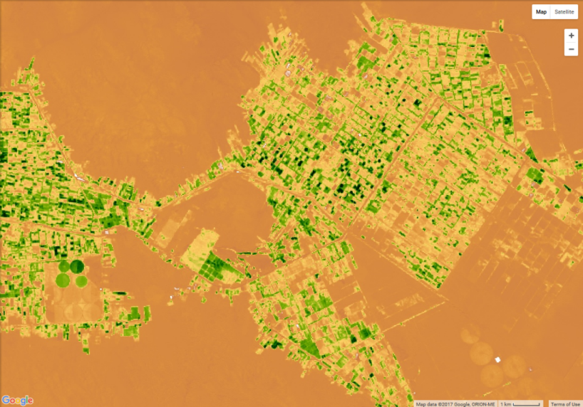
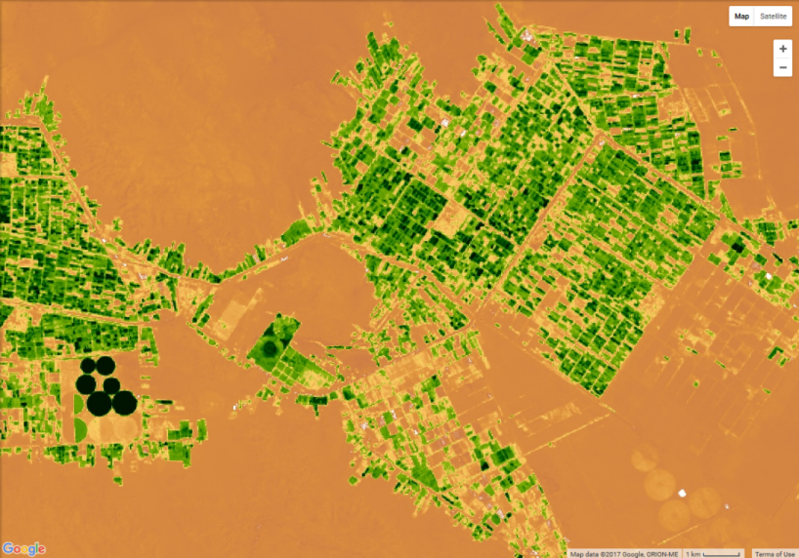
Vegetation Index Time Series – El Noqra Agricultural Expansion
January 2016
Apr-May 2016
March 2016
EVI
High
Low

Slide 36
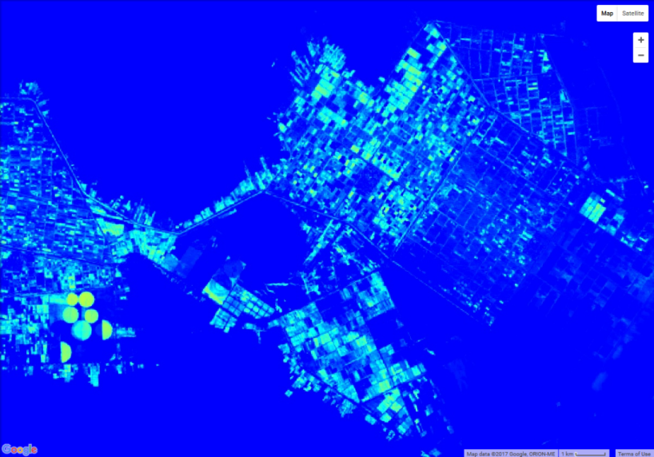
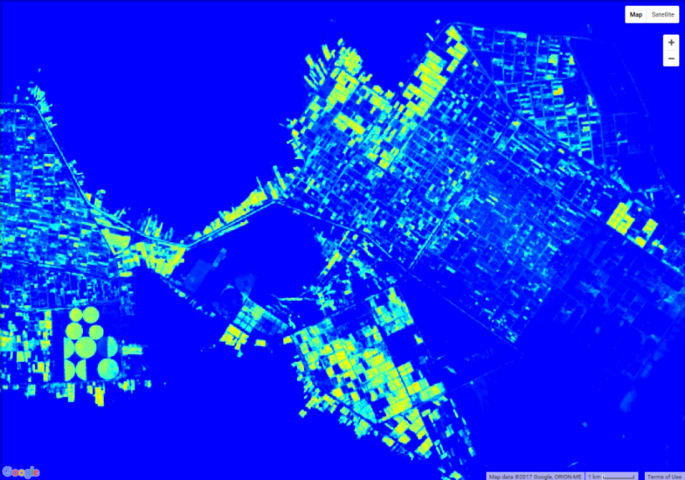
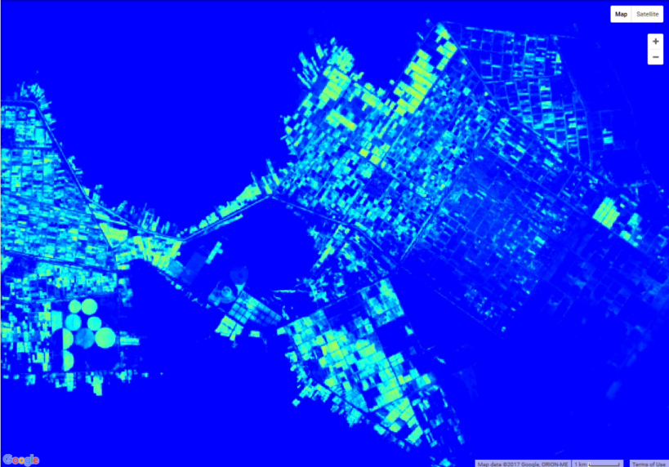
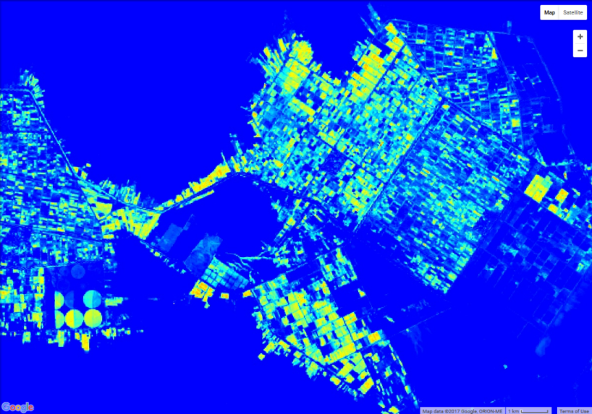
Water Index Time Series – El Noqra Region
May-June 2015
Sep-Oct 2015
Jul-Aug 2015
Nov-Dec 2015
NDWI
High
Low
NDWI = ( NIR – SWIR ) / ( NIR + SWIR )
Notes:
Monitoring the soil moisture level of crop fields is one of the most important thing to do for having an optimal crop yield. Values range from -1, very bad moisture level, to 1 very high moisture level.

Slide 37
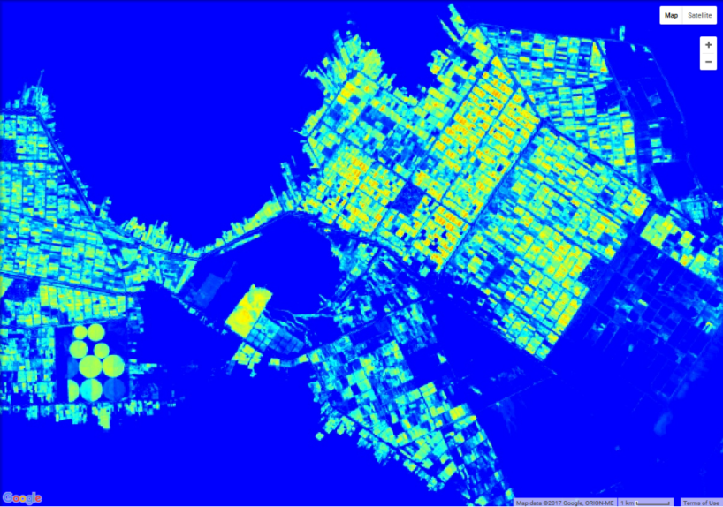
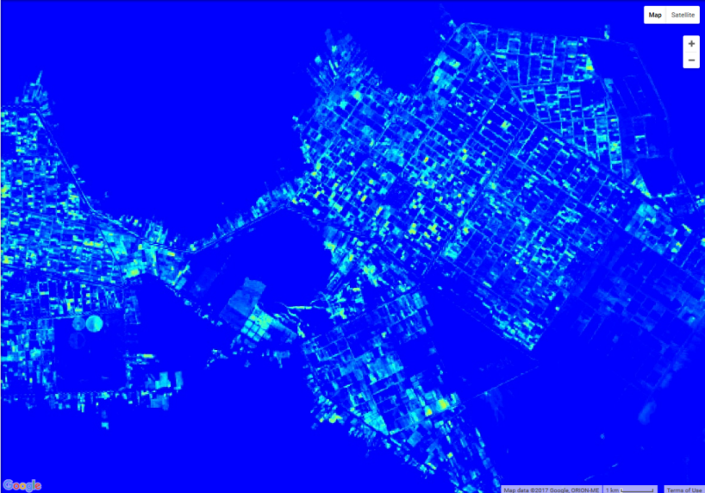
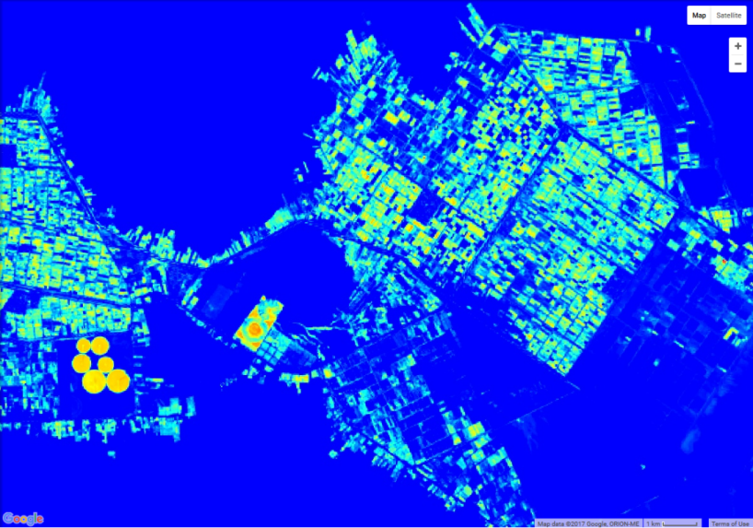
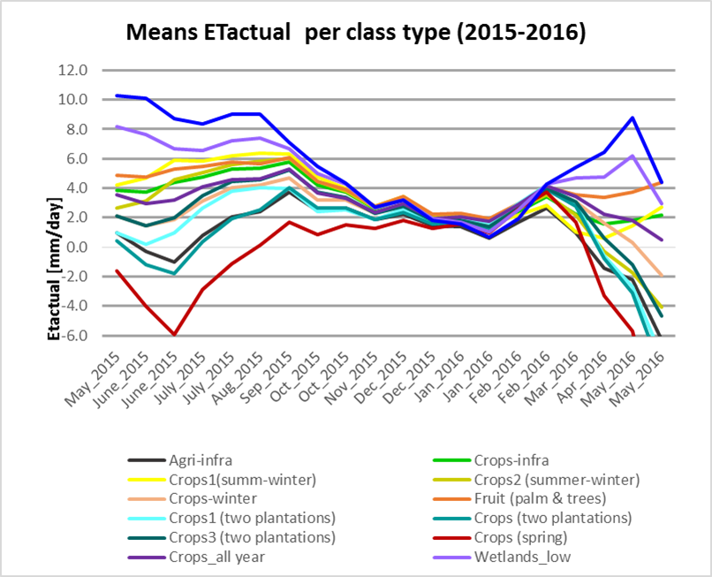
Water Index Time Series – El Noqra Region
January 2016
Apr-May 2016
March 2016
NDWI
High
Low
Notes:
By monitoring not only cropping activities but also crop water consumptions from space, decision makers will be able to implement regulations to help reduce over-exploitation of aquifers, reduce soil and water salinization problems, and optimize the scheduling of irrigation. ET estimates from EEFLUX which uses the METRIC model within the Google Earth Engine.

Slide 38
Remote Sensing of Agriculture
Identification of vegetation types (crops) and their areal extent ⇒ change detection
Maps of distribution, amount, type, and seasonal changes of vegetation patterns allow determination of rates of evapotranspiration, type of irrigation system used, and amount of water consumption
Accurate & frequent crop type maps are needed to improve water management in irrigated agriculture
Specific crop type mapping in Egypt is especially challenging because of small parcel sizes and diversified agricultural land use

Slide 39

Thank You

