Slide 1
NGA NURI Project: Benchmark data development to classify damage for natural disaster relief efforts
War related damage assessment in Kyiv, Ukraine, using Sentinel-1 radar and Sentinel-2 optical images
PI: Laurie G. Baise
Co-PI: Magaly Koch (BU) and Babak Moaveni (Tufts)
Civil and Environmental Engineering Department
School of Engineering
Tufts University

Slide 2

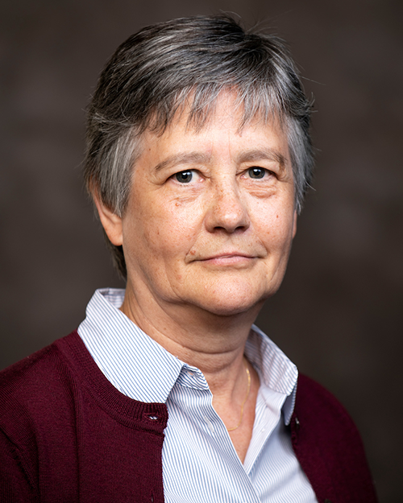
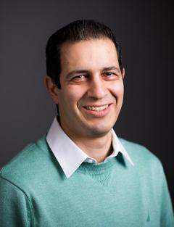
Laurie Baise, Professor and Chair, Tufts
-seismic hazard mapping
-geospatial data
-liquefaction inventories
Magaly Koch, Associate Research Professor, BU
-remote sensing
-coastal hazards
Babak Moaveni, Professor, Tufts
-structural damage detection
-uncertainty assessment

Slide 3
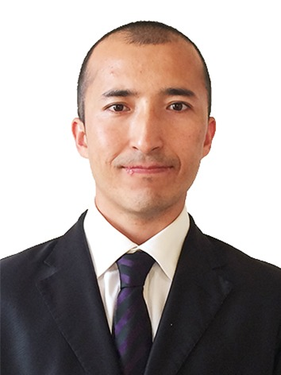
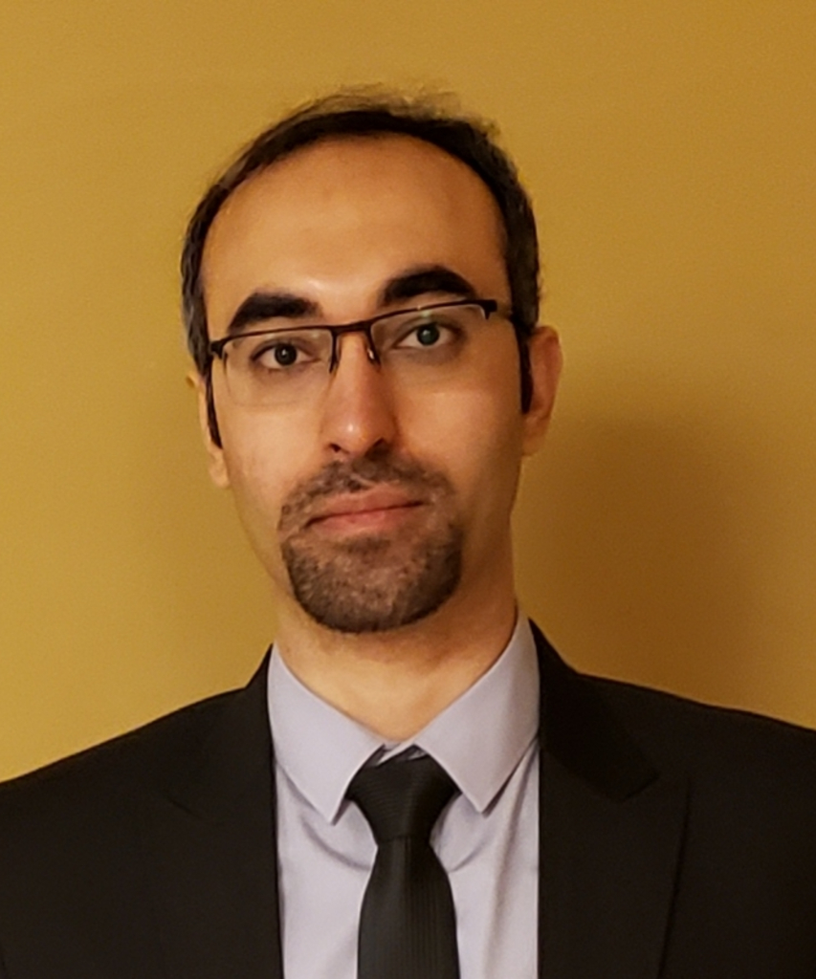

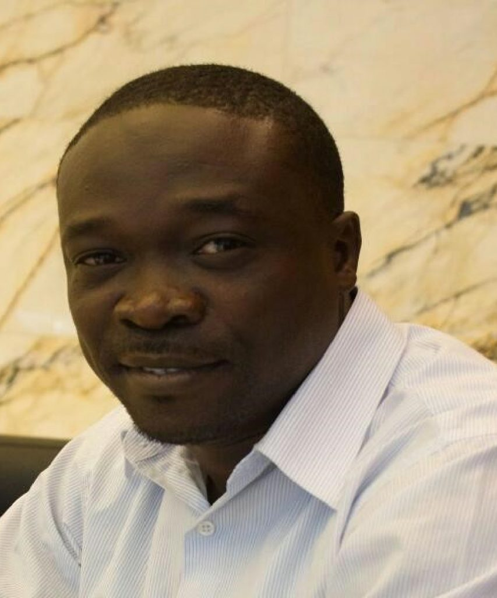
Post-docs and Graduate Students
Yusup Aimaiti
Boston Univ., Post-doc
SAR/Optical image processing
Supervised classification
Data fusion
Adel Asadi
Tufts, Ph.D. student
Supervised classification
Data fusion
Ground failure
Christina Sanon
Tufts, Ph.D. student
Image library
Ground failure/road damage
Lekan Sodeinde
Tufts, Ph.D. candidate
Building damage

Slide 4
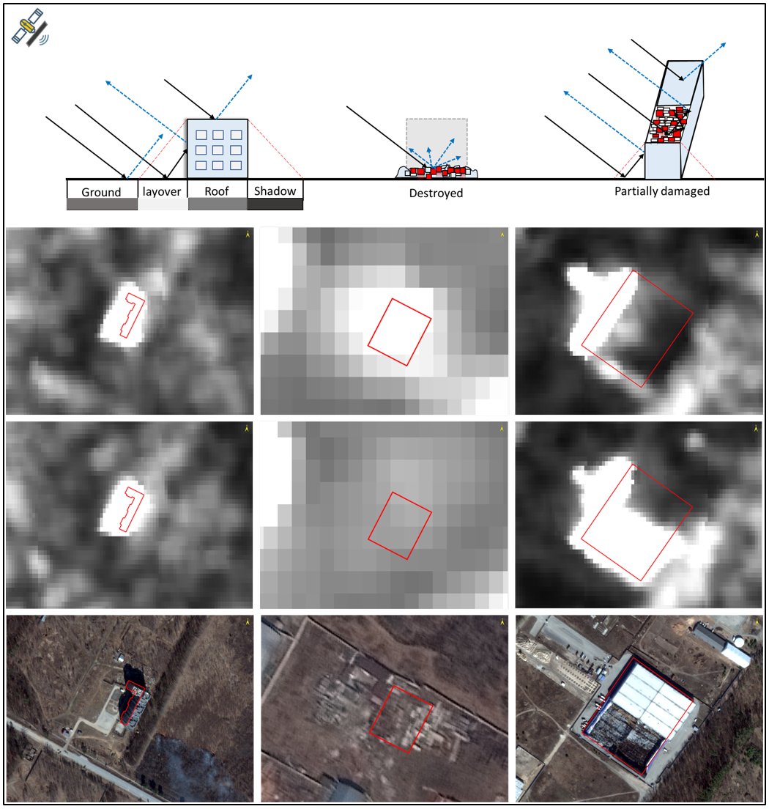
How can we extract damage from remotely sensed imagery after natural and man-made events?
Change in SAR backscatter intensity
SAR backscattering intensity - will vary from intact to partially damaged to destroyed buildings.
Backscatter intensity decreases when the building is damaged due to the altered geometry (reduced height)
A partially damaged building may increase the backscatter intensity by creating a double-bounce effect
We use the robust SAR log ratio of backscatter intensity
Intact
Pre
Destroyed
Pre
Partially Damaged
Pre
Post
Post
Post
WV2
WV3
WV2

Slide 5
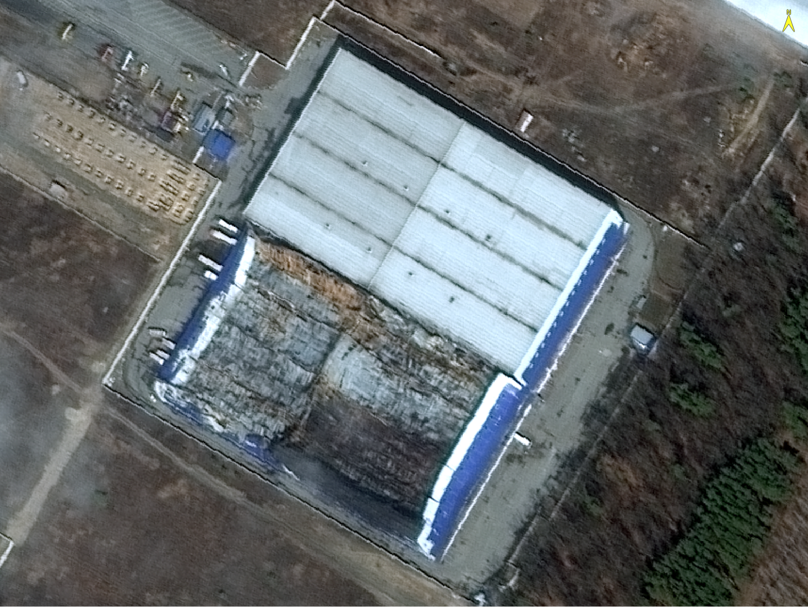
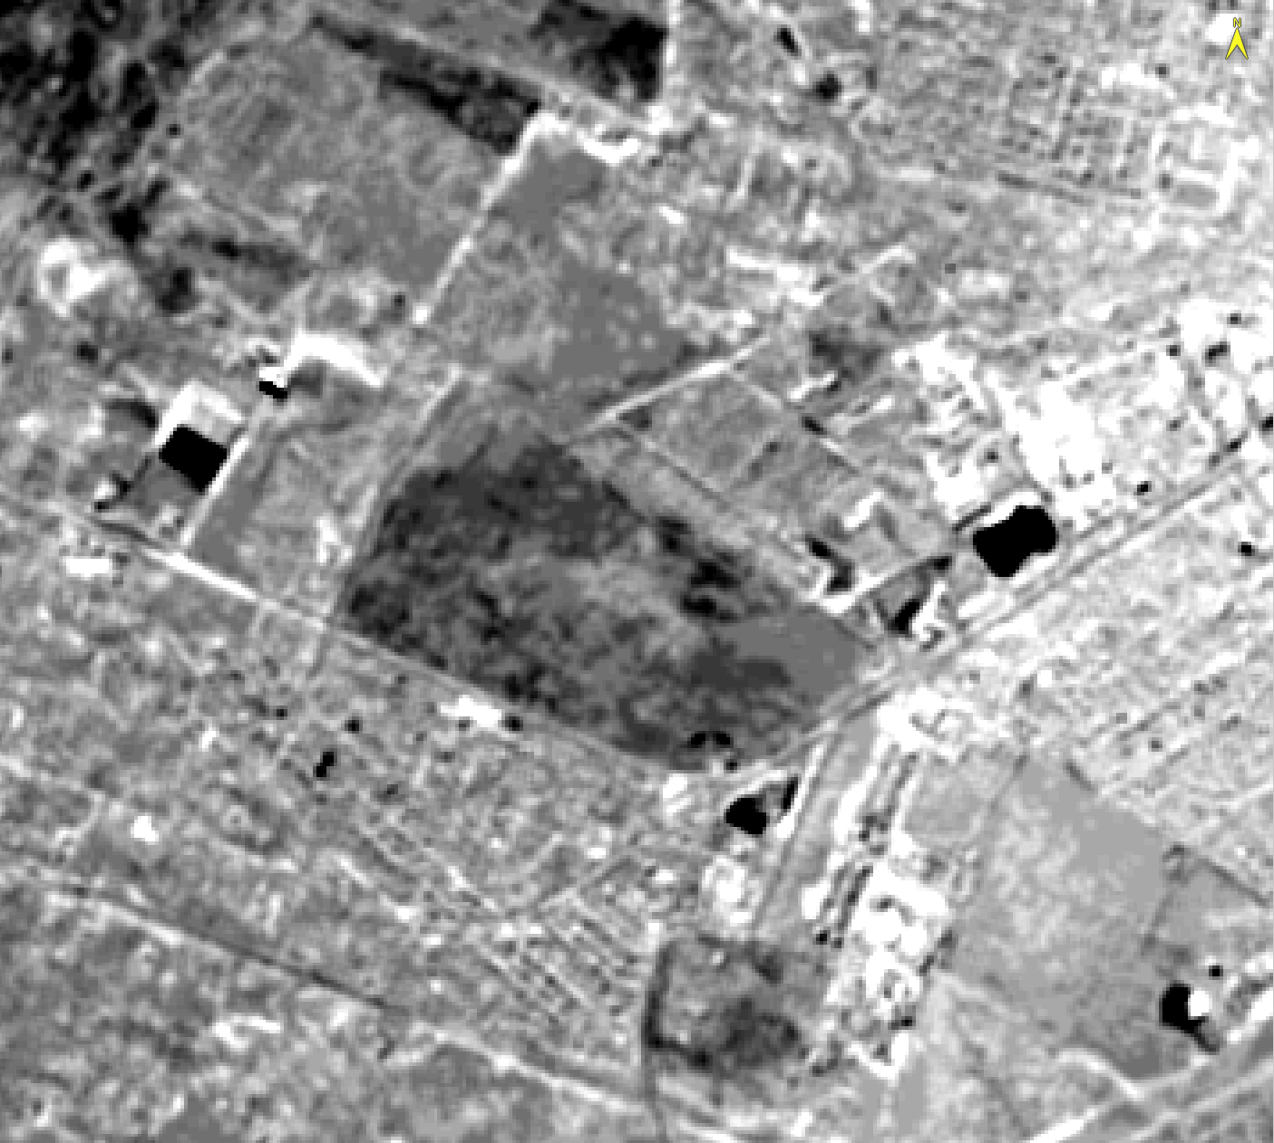
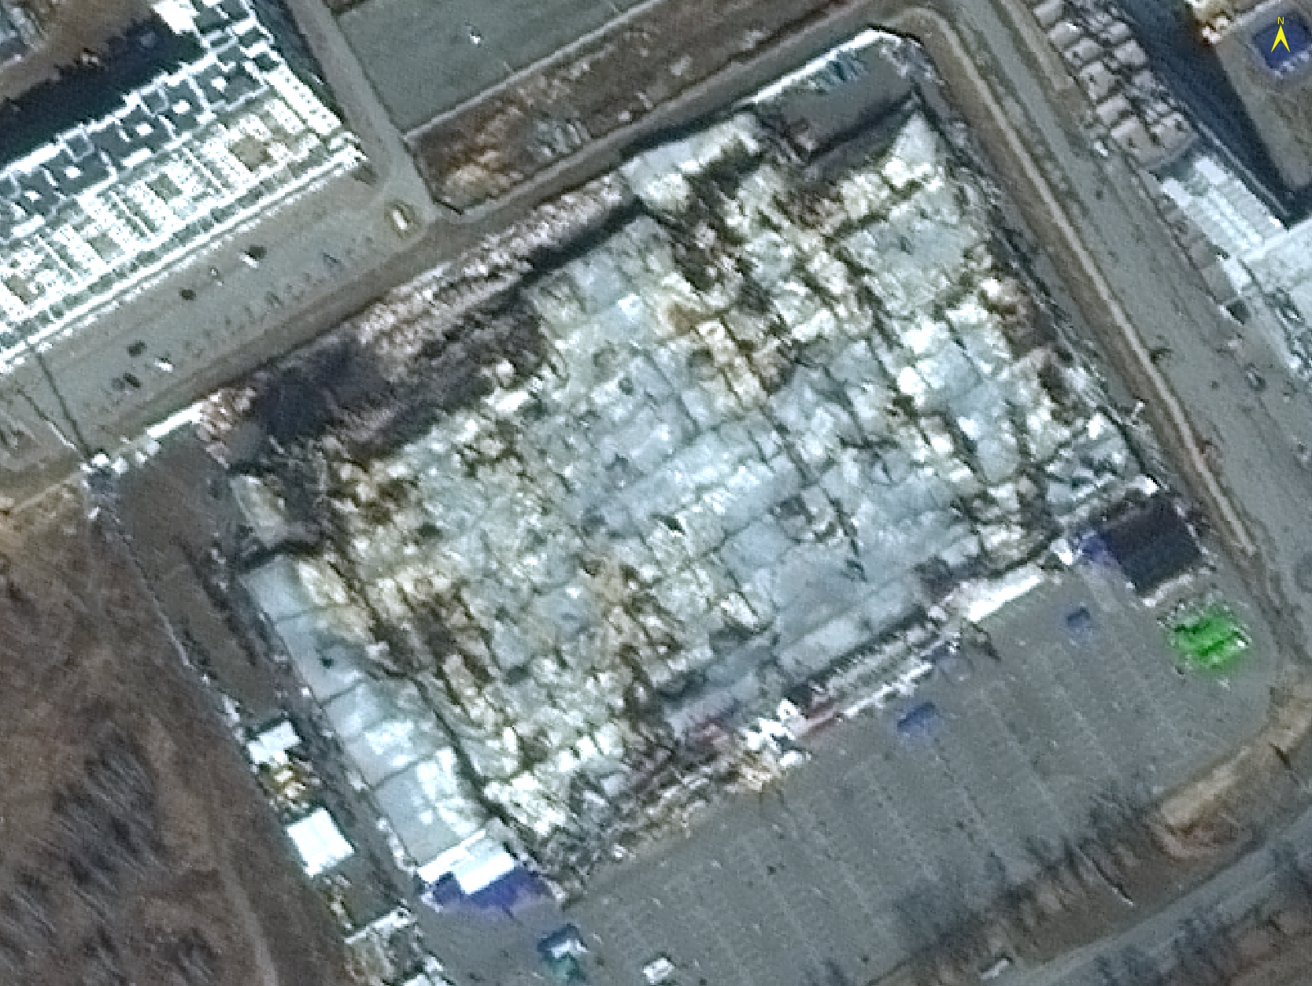
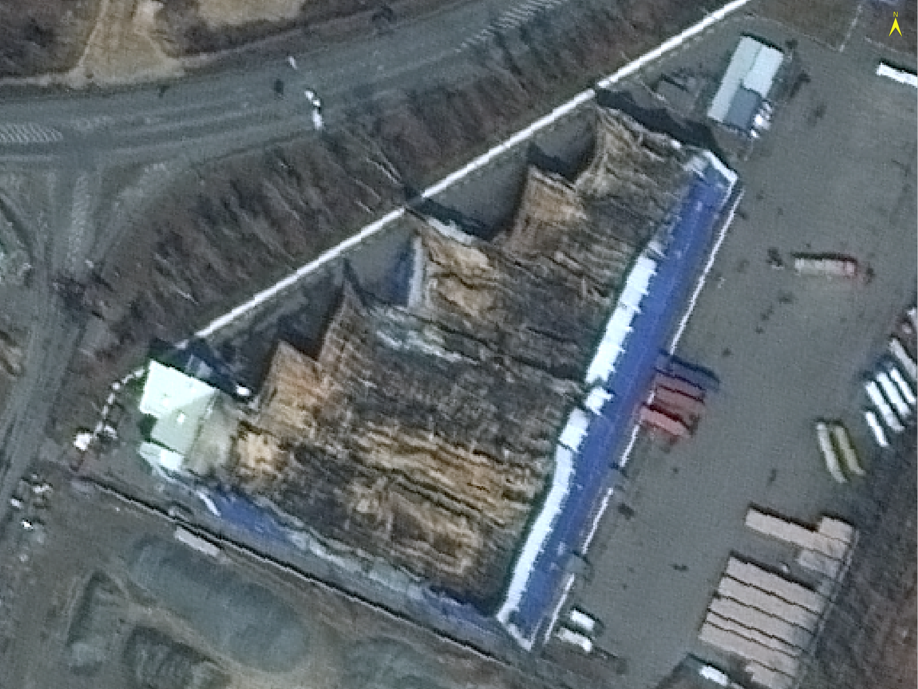
Change in 0ptical texture :
Haralick’s Gray Level Co-occurrence Matrix (GLCM) second-order matrix that shows the relationship between a pixel and its neighbors: yielding high values for a neighborhood that contains few coherent edges
How can we extract damage from remotely sensed imagery after natural and man-made events?

Slide 6
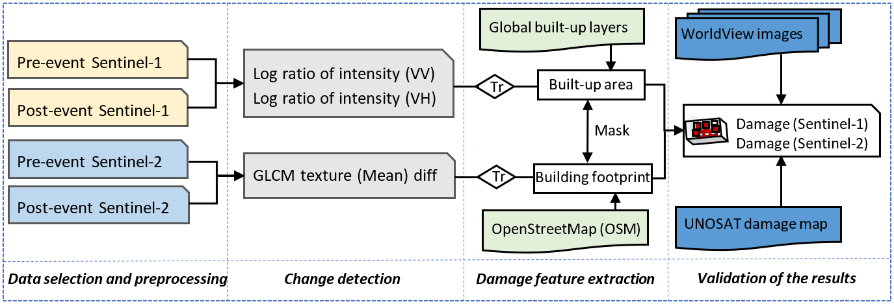
Project framework

Slide 7
Research questions:
Can change detection using the log-ratio of medium resolution SAR backscatter intensity (Sentinel-1) be used to identify building damage?
Can change detection of the Gray Level Co-occurrence Matrix (GLCM) texture using medium resolution optical (Sentinel-2) be used to identify building damage?
Does using a building mask (OSM building footprints or a built-up index) improve performance?

Slide 8
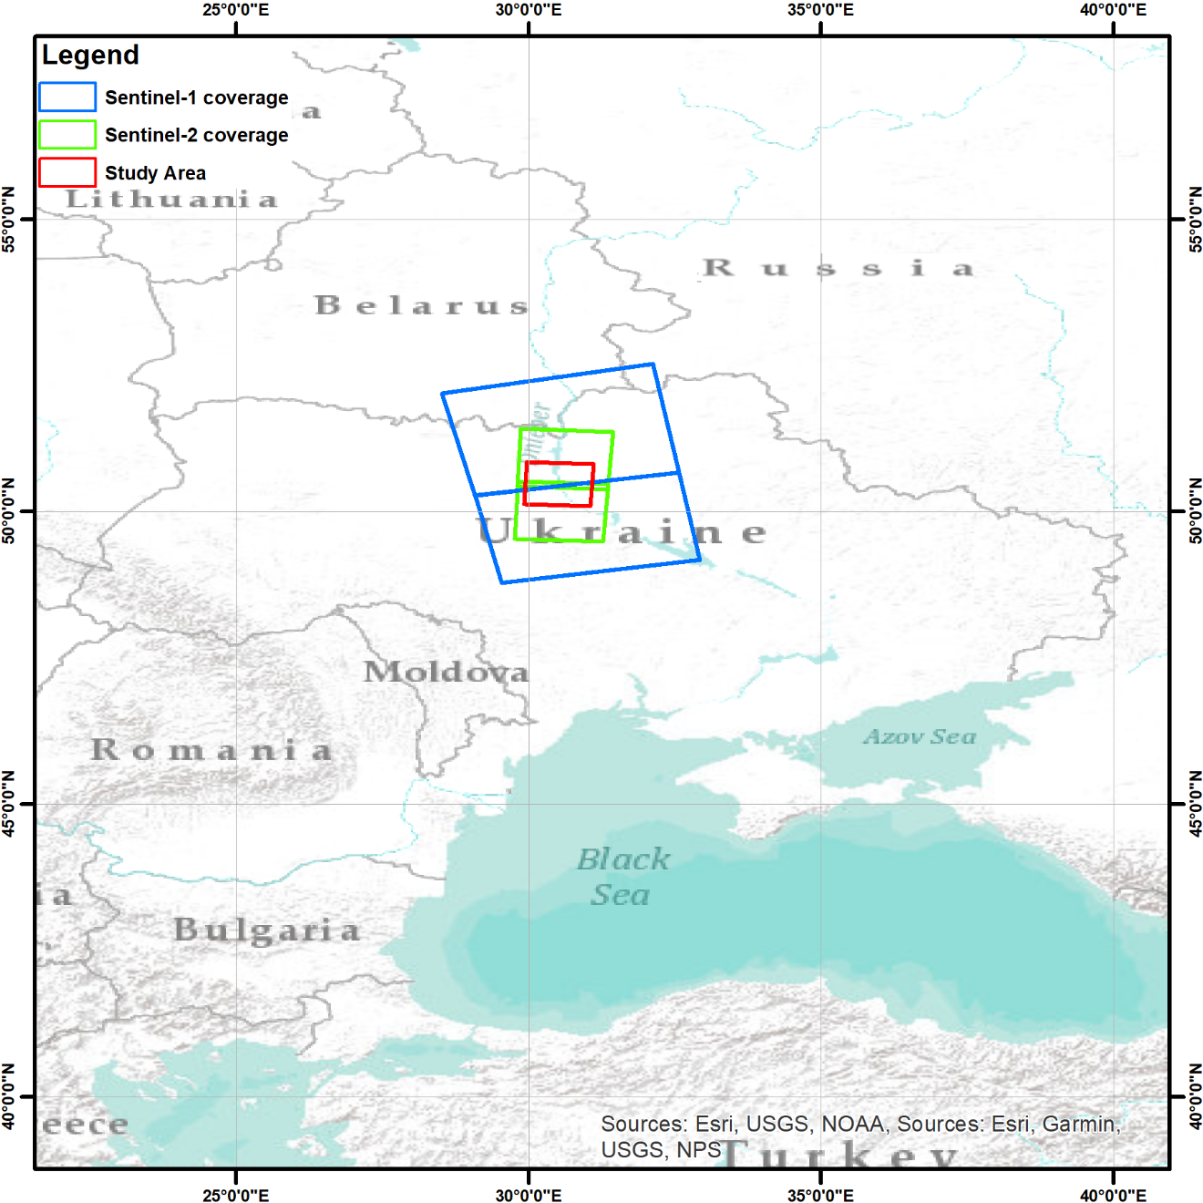
Available Satellite imagery
We searched images that cover Kyiv, the capital city of Ukraine, and the surrounding areas.
Optical image |  | SAR image
Sentinel-2 (10 m) | Worldview 2/3 (0.5 m) | Sentinel-1 (10 m)
03/28/2021 | 02/28/2022 | 02/16/2022
01/02/2022 | 03/25/2022 | 02/19/2022
04/07/2022 | 03/31/2022 | 04/05/2022
 | 05/09/2022 | 04/08/2022
Kyiv
Ukraine

Slide 9
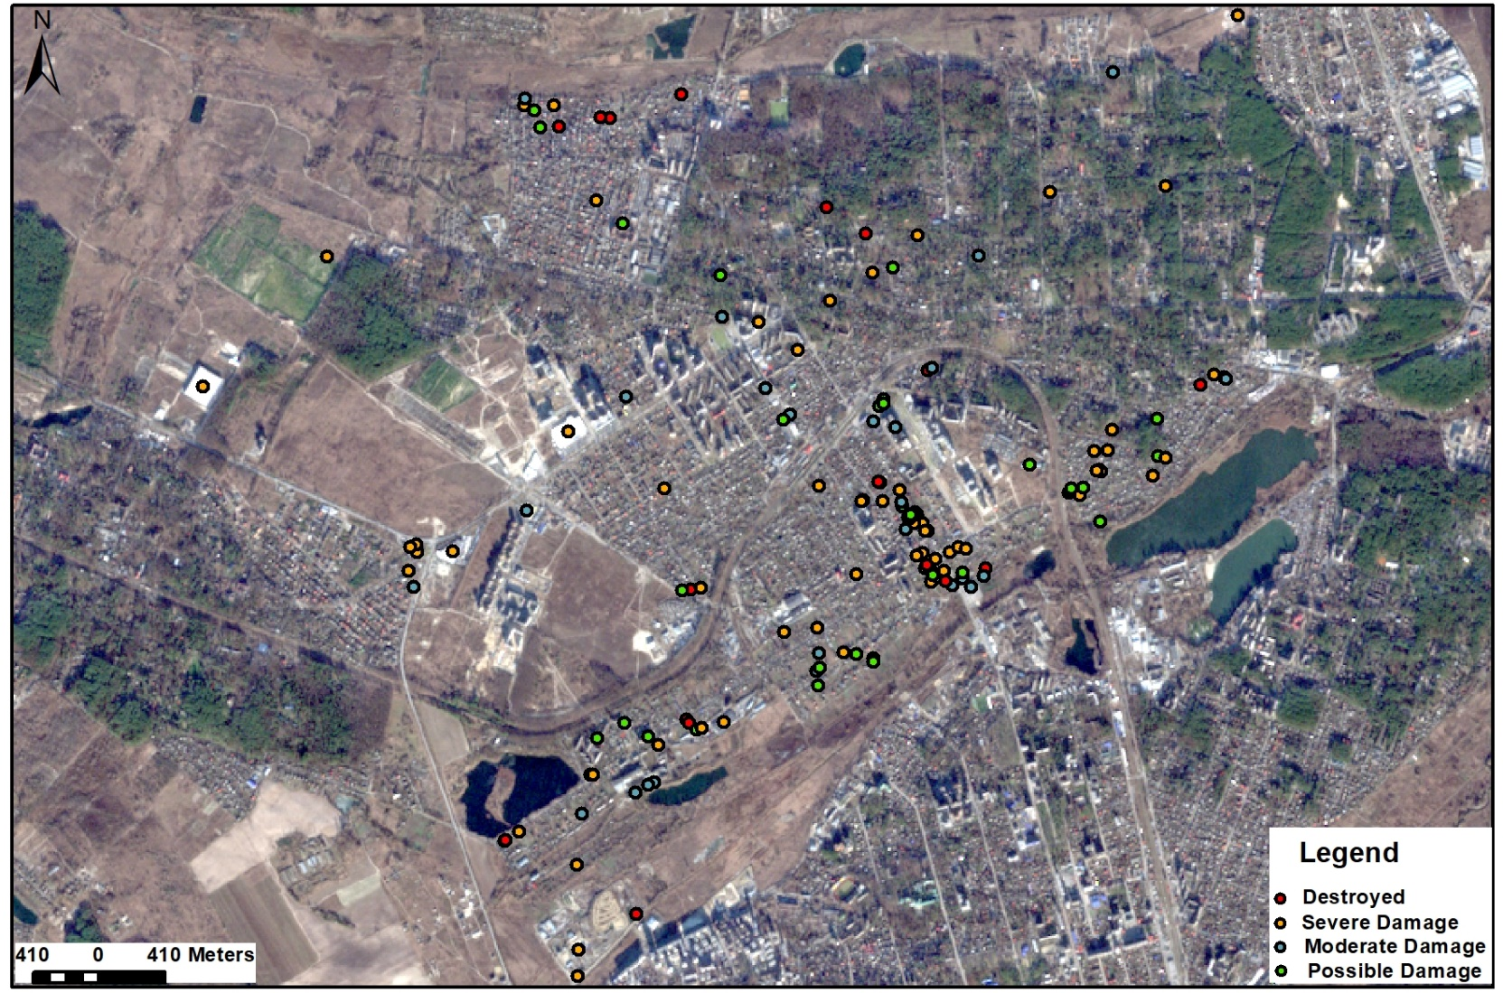
UNOSAT damage assessment of Bucha city
UNOSAT building damage labels in Bucha city (a small area with study area) are used to evaluate accuracy
Figure. UNOSAT damage assessment map of Bucha city. The background image is from Sentinel-2 acquired on January 2, 2022.

Slide 10
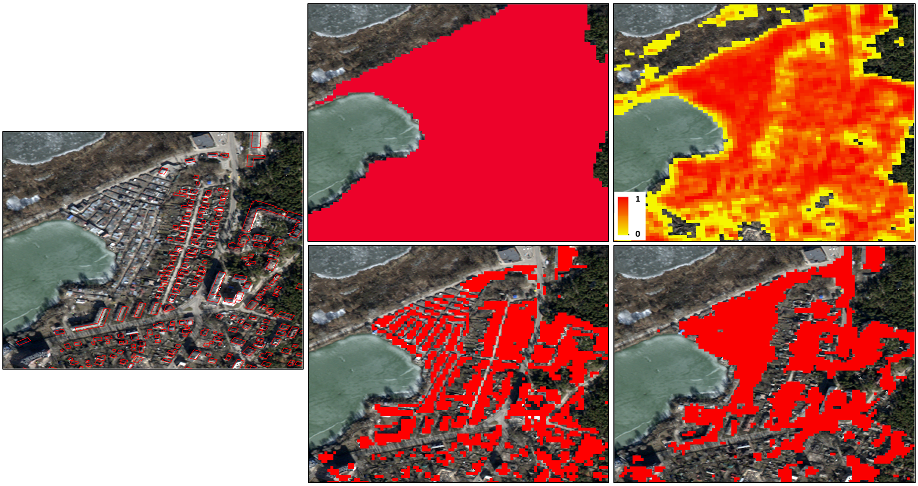
Building masks
ESRI landcover
GHSL
OSM building footprints are detailed but not complete
ESRI landcover and GHSL are too general and are not a useful mask
World Settlement Footprint provides the most detailed AND complete mapping of buildings
OSM is used in small test area to evaluate accuracy;
OSM and WSF are both applied for comparison
OSM
WSF
ESA Worldcover
The comparison of (a) OSM building footprint with the (b) ESRI land use/land cover, (c) GHSL, (d) WSF, and (e) ESA WorldCover map.

Slide 11
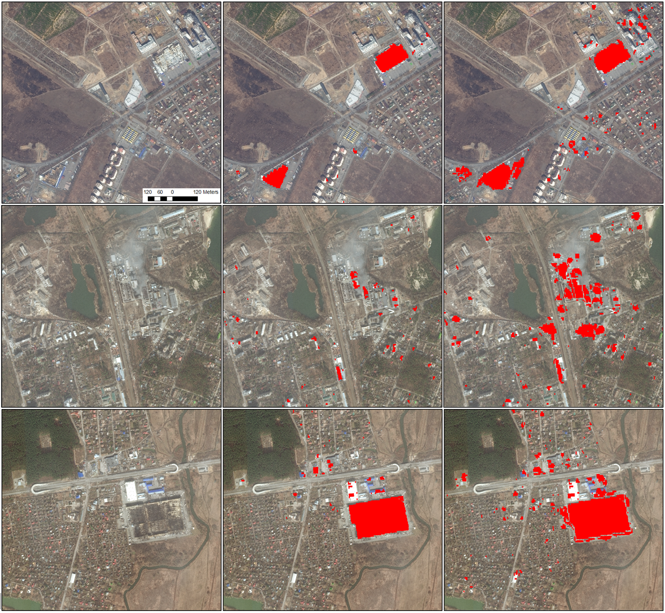
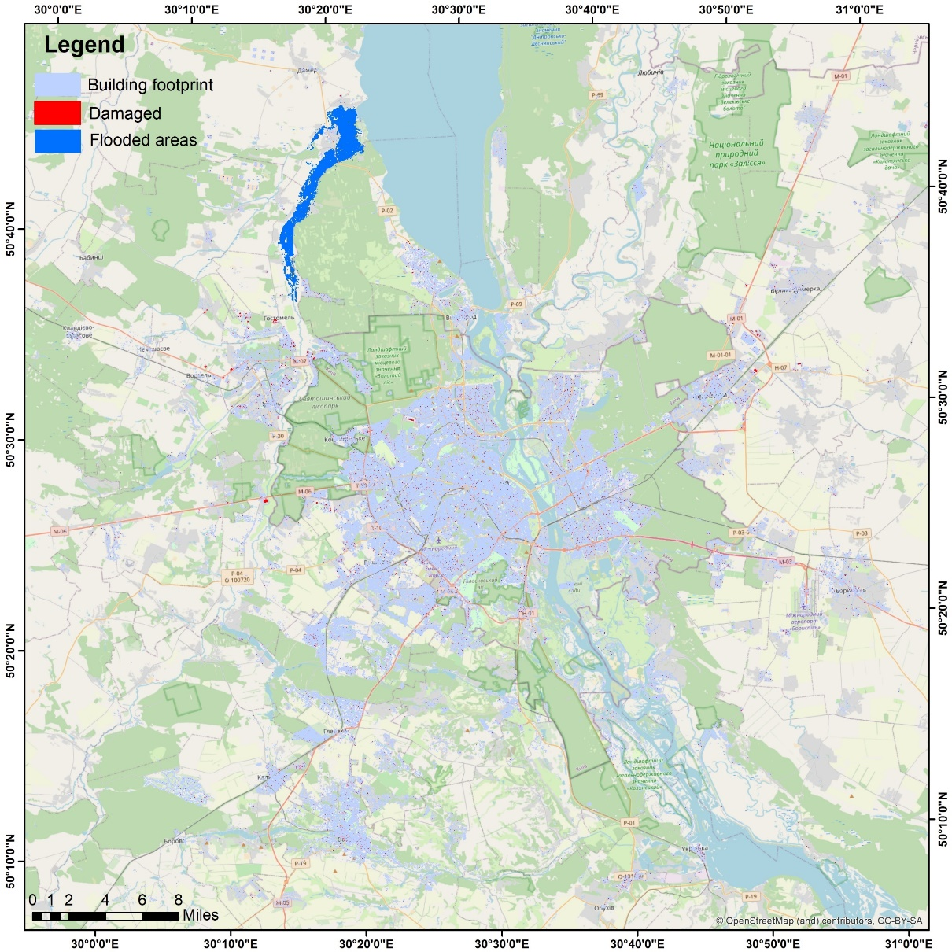
Results: Sentinel-1 SAR Backscatter Intensity Change
a
WV03
OSM mask
WSF mask
Flooded area
b
a
b
c
c

Slide 12
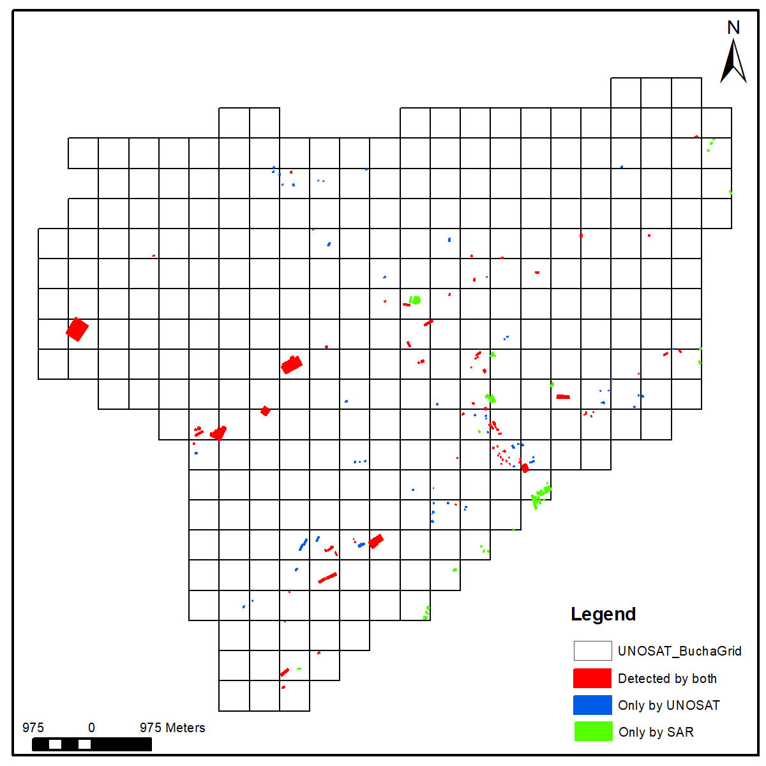
Results: Sentinel-1 SAR Intensity Change: Accuracy vs UNOSAT
Table 2. The statistics of UNOSAT damage levels and SAR intensity-based damaged buildings.
 | Destroyed | Severe Damage | Moderate Damage | Possible Damage | Total
UNOSAT | 19 | 72 | 26 | 28 | 145
Average area m² | 149 | 1280 | 708 | 441 | 867
SAR damaged | 9 | 46 | 15 | 14 | 84
Percentage % | 47 | 64 | 58 | 50 | 58
Open Street Map building footprints were augmented to include all buildings with UNOSAT labels
Destroyed buildings tend to be small M=(average area=149 m²) – and are difficult to identify (accuracy = 47%)
Severely damaged buildings are large (average area=1280 m²) – and are more easily identified (accuracy=64%)

Slide 13
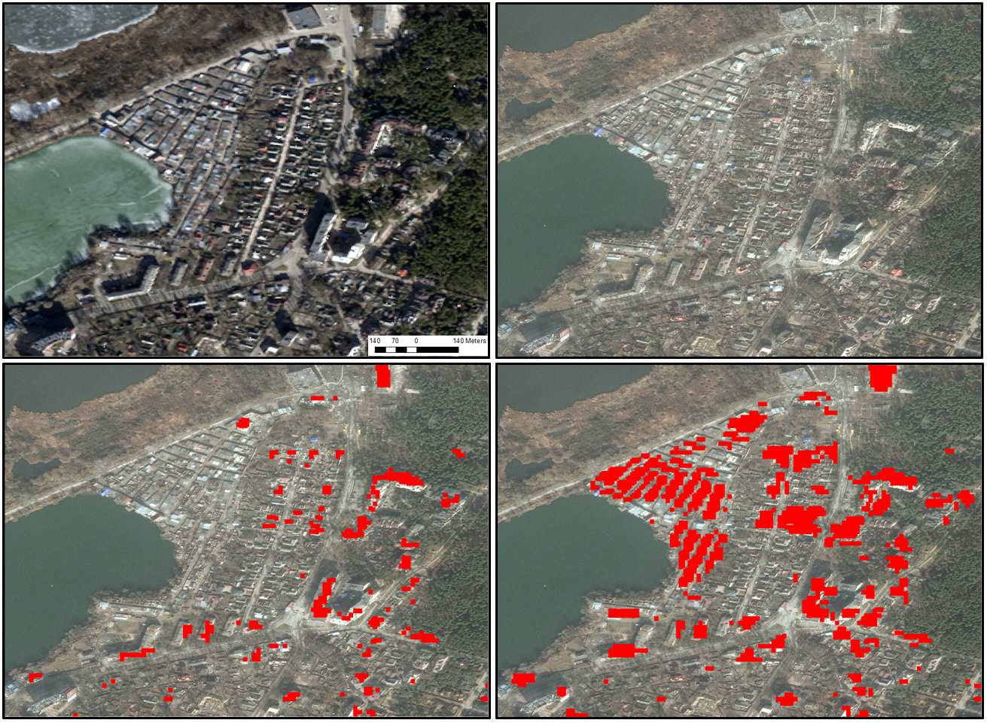
Results: Sentinel-1 SAR Backscatter Intensity Change: Use of Masks
WV2-Pre
WV3-Post
OSM building footprints are significantly incomplete in study area, masking out too much damage
World Settlement Footprint (WSF) is a better alternative as it provides better coverage of built-up area
OSM mask
WSF mask

Slide 14
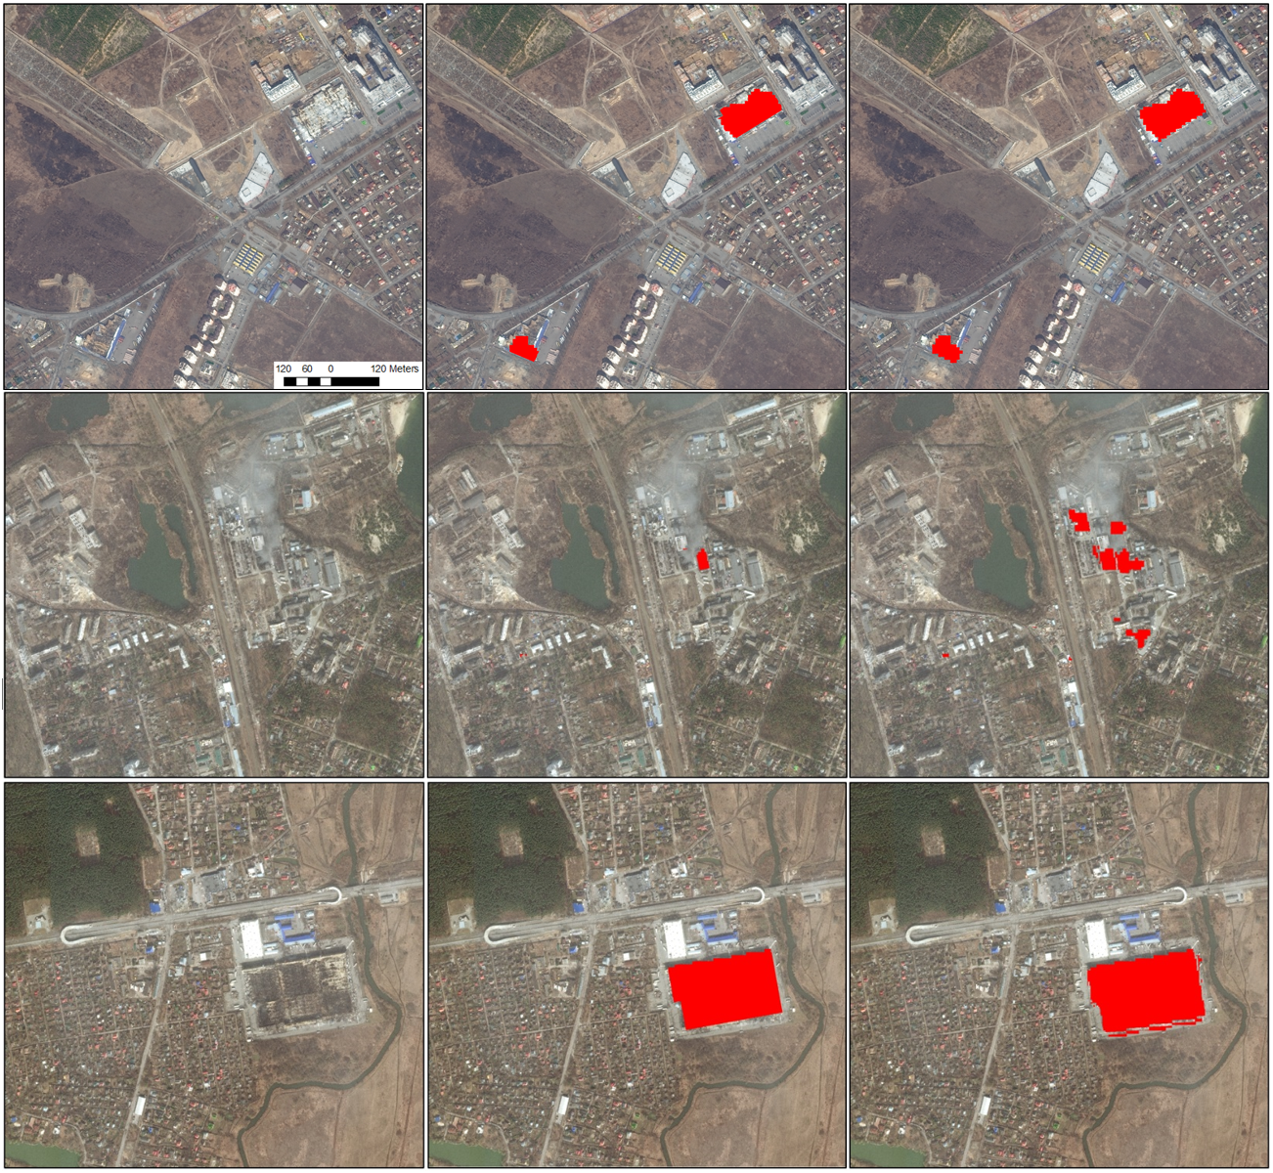
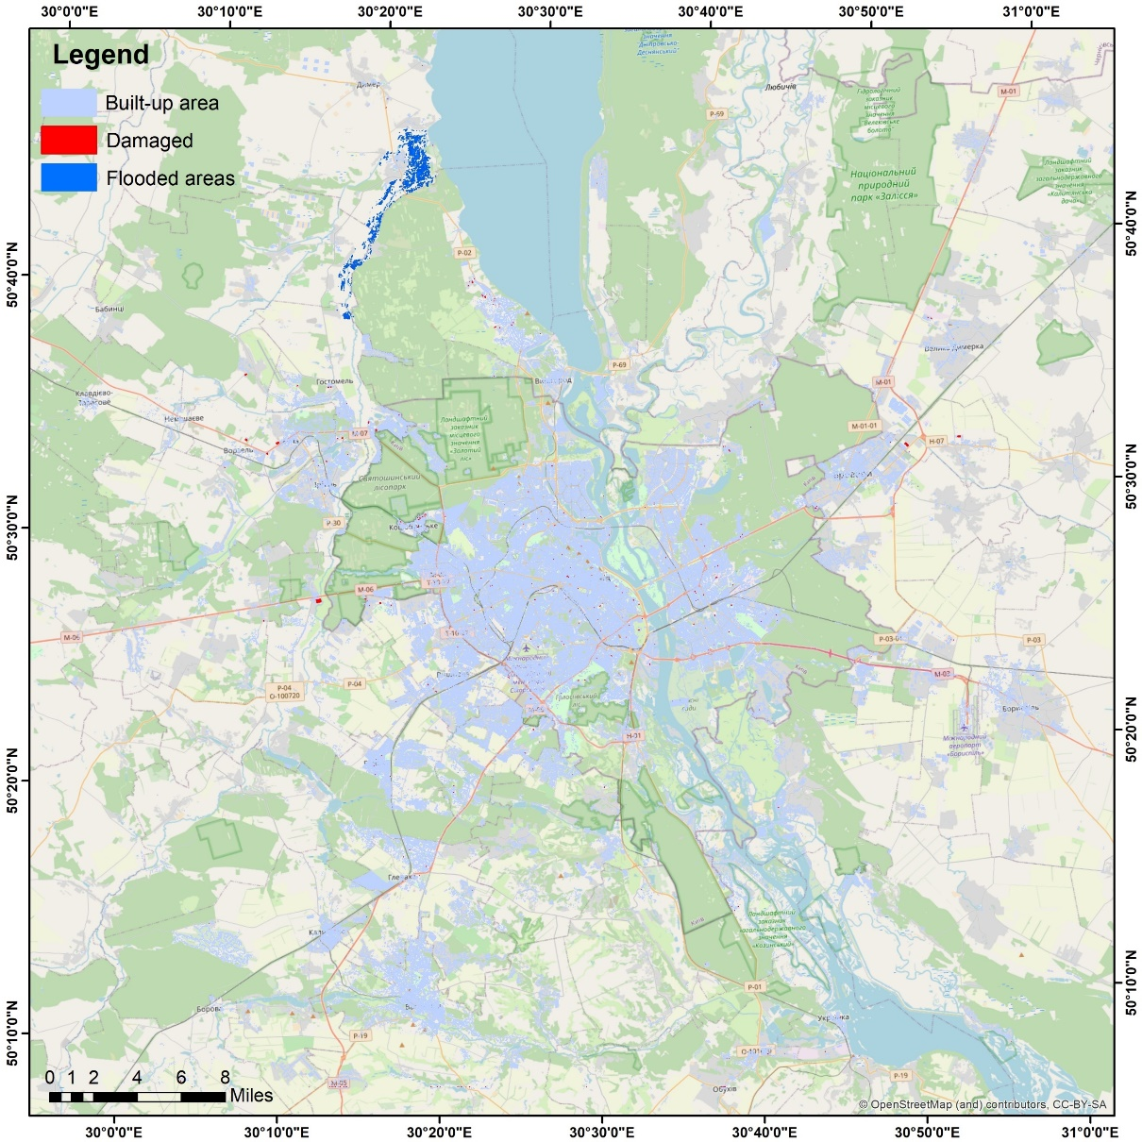
Results: Sentinel-2 GLCM texture optical change
a
WV03
OSM mask
WSF mask
Flooded area
b
a
b
c
c

Slide 15
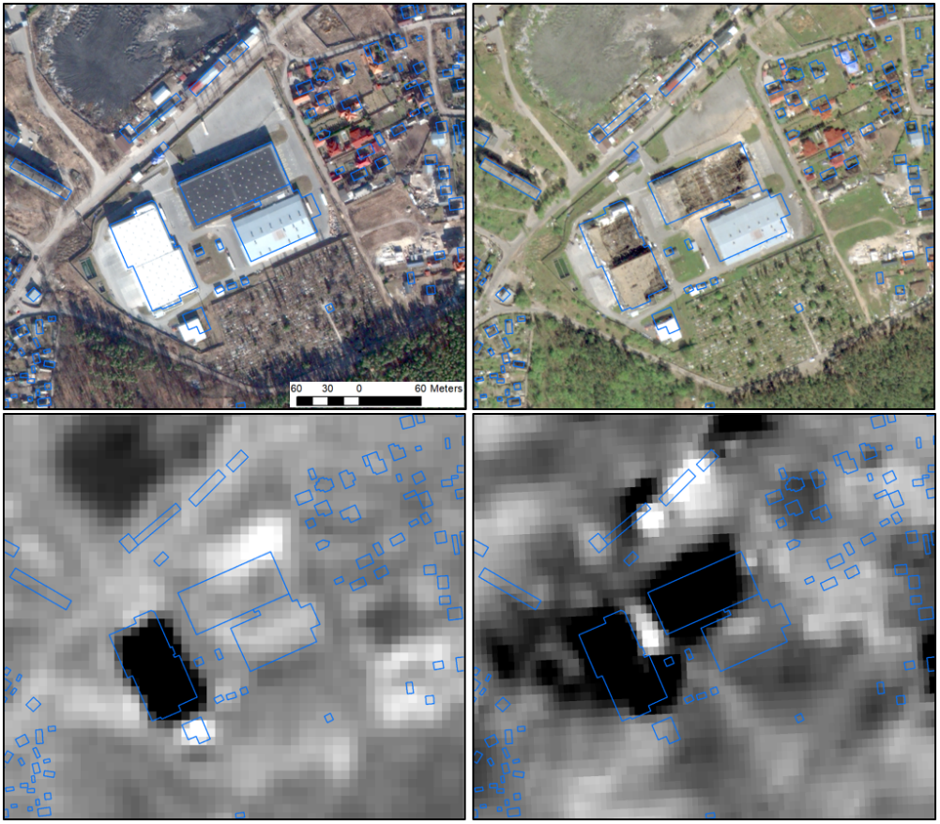
Results: Sentinel-2 GLCM texture optical change
WV2-Pre
WV3-Post
GLCM texture change tends to identify large scale damaged buildings and is not able to differentiate small scale buildings.
Roof color also influences the optical results
S2-Texture
S1-Intensity
The Sentinel-1 SAR intensity versus Sentinel-2 texture and the corresponding WorldView imagery taken on February 28, 2022 and May 09, 2022. The blue polygons are the OSM building footprints overlaid on the images for better comparison.

Slide 16
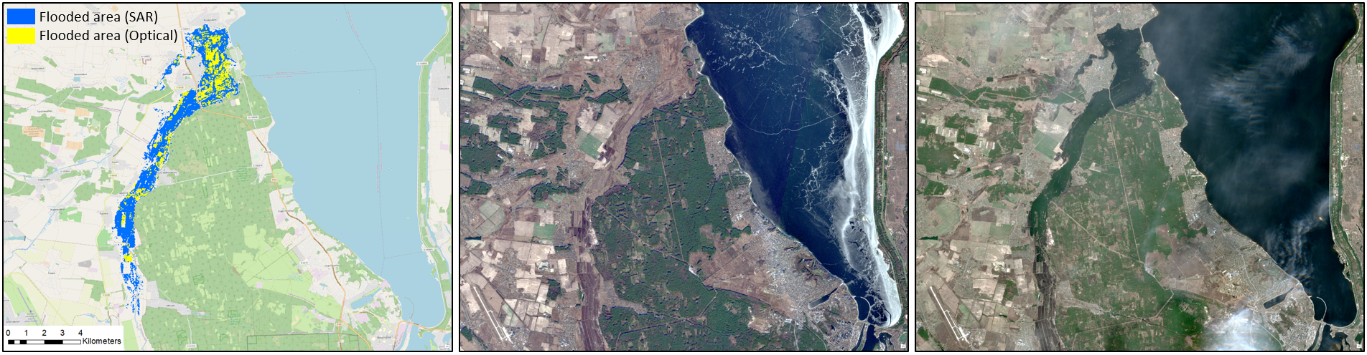
Detection of flooded area
A
January 02, 2022
B
April 07, 2022
C
A. The flooded areas detected by the Sentinel-1 log ratio and the Sentinel-2 texture difference. B. Pre-event Sentinel-2 optical image. C. Post-event Sentinel-2 optical image.

Slide 17
Summary
Change detection with Sentinel-1 SAR (10 m) backscatter intensity captures significant building damage
  In Bucha City, where OSM building footprints have been augmented, 58% of damaged buildings are identified (compared to UNOSAT)
    Buildings with small building footprints are harder to detect
    Destroyed buildings tend to be small (average area=149 m²) – and are difficult to identify (accuracy = 47%)
    Severely damaged buildings are large (average area=1280 m²) – and are more easily identified (accuracy=64%)
  OSM Building footprints are incomplete in region, World Settlement Footprints provide better coverage
Change detection with Sentinel-2 optical (10 m) GLCM texture change finds large scale building damage but not as complete as SAR backscatter intensity results.

Slide 18
Questions?

